Slide 1
Revised algorithm for COVID testing

Slide 2
Clarification on the COVID testing algorithm
Director general has released a memo guiding on the sequence of testing between RDTs and PCR testing
Only ABBOT PAN BIO and STANDARD Q test kits currently approved
All data should be reported through the RDS

Slide 3
COVID-19 testing algorithm at COVID treatment units (CTUs)
NOTE:
The goal of Genexpert PCR testing at CTUs is to enable them admit only confirmed patients & thus decongest them.
Only patients with symptoms are eligible for AG. RDT & PCR testing (including GXP)
Ensure to keep aliquots of the positive samples for referral to do genomic sequencing
The PCR sample must be collected immediately after the RDT result.
SYMPTOMATIC PATIENT OR AUTOPSY
Ag. RDT TEST
POSITIVE
NEGATIVE
MANAGE AS POSITIVE
PCR e.g. GXP
POSITIVE
NEGATIVE
MANAGE AS POSITIVE
MANAGE AS NEGATIVE

Slide 4
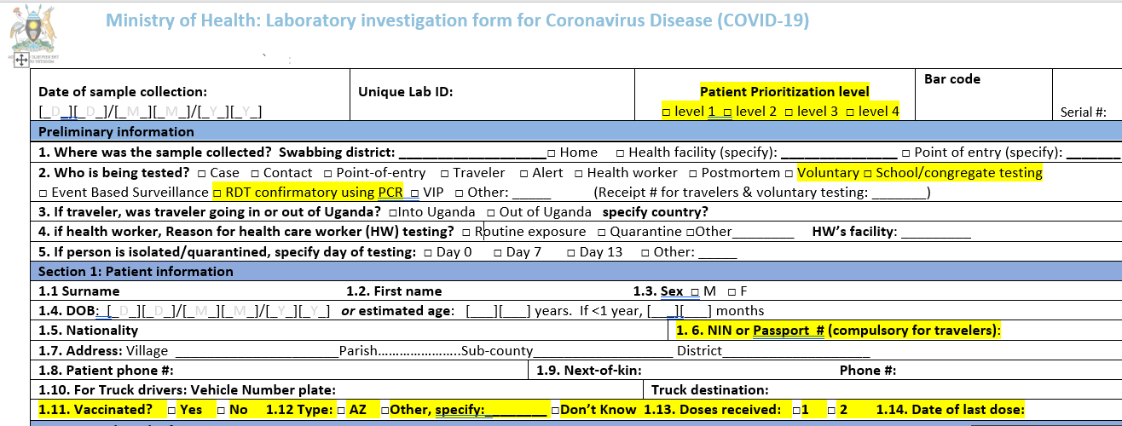
Revision of the lab investigation form
Yellow highlights show key changes made to request form

Slide 5
Development of a paper based COVID lab register

Slide 6
Categories for prioritizing Testing for COVID-19
Priority 1 | Priority 2 | Priority 3 | Priority 4
Immediately TAT <24 Hrs | Urgently Test TAT 24 – 36 Hrs | Urgent Testing TAT <48Hrs | Priority Testing TAT <72Hrs
Admitted Cases in Care | Symptomatic Alert or Contacts | Risk Based Surveillance Testing | Community Based testing for low risk symptomatic persons
Symptomatic HCWs | Quarantine if symptomatic Targeted surveillance that informs interventions | VVIP, Travelers, Truck Drivers – Cost recovery | Surveillance testing of asymptomatic persons
Symptomatic Alert or Contacts in Congregate settings ( Police Cells/PRISONS) | Symptomatic Alert or Contacts aged >65 Years of age with co-morbidities. | Asymptomatic Frontline HCWs | Asymptomatic Contacts
Notes:
In light of increasing demand for testing yet

