Slide 1
Overview of the Novel Corona Virus Disease (COVID-19
Introductory Module: 1
Developed with input from MOH, WHO,CDC,IDI
HEALTH

Slide 2

Learning objectives
At the end of this lecture, you will be able to:
Describe Reservior, transmission and clinical presentation of COVID-19 infection.
Compare COVID-19 infection to MERS and SARS, other coronavirus.
Provide links to WHO case definition and other guidance
HEALTH

Slide 3
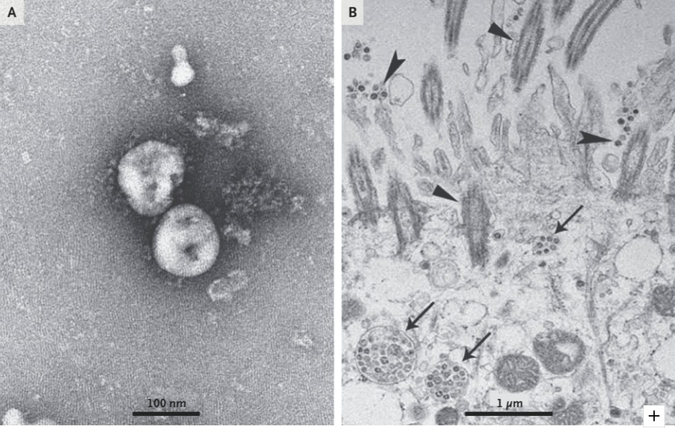
2019-novel Coronavirus
Electron microscopy:
A COVID-19 virus particles
B COVID-19 particles within human airway epithelial cells
Na Zhu et al. A Novel Coronavirus from Patients with Pneumonia in^{HEALTH}
China, 2019. DOI: 10.1056/NEJMoa2001017

Slide 4
Coronaviruses (1/3)
Large, enveloped, positive-strand RNA viruses
4 human (H)CoVs cause 10-30% of URTIs in adults
SARS-CoV, MERS-CoV & COVID-19 cause severe human infections.
Other SARS-like CoVs have been found in animal reservoirs but have not yet been detected in humans
HEALTH

Slide 5
Coronaviruses (2/3)
Key feature of coronaviruses which cause Severe Acute Respiratory Infection (SARI):
Limited human-human transmission, predominantly nosocomial (MERS > SARS).
Viral replication in the lower respiratory tract.
Aberrant host immune response (upregulation of pro- inflammatory cytokines).
HEALTH

Slide 6
Coronaviruses (3/3)
NAME | ANIMAL RESERVOIR | BINDING RECEPTOR (predominant) | RECEPTOR LOCATION (predominant) | NUMBER OF CASES TO DATE* | CASE FATALITY RATE
SARS-CoV | Bats | ACE2 | Lower resp tract | 8098 | 10%
MERS-CoV | Dromedaries | DPP4 | Lower resp tract GI tract, kidneys | 2494 | 34%
CORVID-19 | ? | ACE2 | Lower resp tract | 7783 | ?
SARS-CoV- like# | Bats | ACE2 | (in vitro only)
* As of 30 Jan 2020
HEALTH
# No human infections yet

Slide 7
CASE DEFINITION
Patients with severe acute respiratory infection (fever, cough, and requiring admission to hospital), AND
with no other aetiology that fully explains the clinical presentation AND at least one of the following:
  a history of travel to or residence in the city of Wuhan, Hubei Province, China in the 14 days prior to symptom onset,
or
  patient is a health care worker who has been working in an environment where severe acute respiratory infections of unknown aetiology are being cared for.
Patients with any acute respiratory illness AND at least one of the following:
  close contact with a confirmed or probable case of COVID-9 in the 14 days prior to illness onset, or
  visiting or working in a live animal market in Wuhan, Hubei Province, China in the 14 days prior to symptom onset,
or
  worked or attended a health care facility in the 14 days prior to onset of symptoms where patients with hospital associated 2019-nCov infections have been reported.
HEALTH

Slide 8
CORVID-19- TRANSMISSION
Cluster of cases of pneumonia reported in Wuhan on 31 Dec 2019, with 1st case symptomatic on 8 Dec
Initial cases associated with a market in Wuhan
Rapid spread within Wuhan and to many other Chinese provinces and other countries
Human-human transmission, but full extent not yet known
Nosocomial transmission to HCWs has occurred
• Spread is through droplets and contact
HEALTH

Slide 9
2019-nCoV - EPIDEMIOLOGY*
Age: 59 years (15-89)
Males 56%, females 44%
Market exposure:
  before January 1 - 64%
  January 1-11 - 16%
  January 12-22 - 6%
Incubation period 5.2 days (4.1-7.0 95% CI)
RO value 2.2 (1.4-3.9 95% CI)
*Qun Li, M.Med., Xuhua Guan, Ph.D., Peng Wu, Ph.D., Xiaoye Wang, M.P.H., Lei Zhou, M.Med., et al. Early Transmission Dynamics in Wuhan, China, of Novel Coronavirus–Infected Pneumonia. DOI: 10.1056/NEJMoa2001316
HEALTH
EMERGENCIES
programme

Slide 10
CORVID-19 - CLINICAL FEATURES
Incubation period may be 5.2 days; patients may be infectious during this time
Symptoms at onset*:
fever (98%),
dry cough (76%),
fatigue & myalgia (44%),
sputum production (28%),
headache (8%),
haemoptysis (5%),
diarrhoea (3%)
Subsequent symptoms:
dyspnoea (25%)
Qun Li, M.Med., Xuhua Guan, Ph.D., Peng Wu, Ph.D., Xiaoye Wang, M.P.H., Lei Zhou, M.Med., et al. Early Transmission Dynamics in Wuhan, China, of Novel Coronavirus–Infected Pneumonia. DOI: 10.1056/NEJMoa2001316

Slide 11
COVID-19 COMORBIDITIES*
Any co-morbidity: 32%
Diabetes 20%
Hypertension 15%
Cardiovascular disease 15%
COPD 2%, malignancy 2%
Chronic liver disease (2%)
*from initial group in Wuhan: https://doi.org/10.1016/S0140-6736(20)30183-5
HEALTH

Slide 12
COVID-19 - CLINICAL FEATURES
Incubation period may be 5.2 days; patients may be infectious during this time
Symptoms at onset*: fever (98%), dry cough (76%), fatigue & myalgia (44%), sputum production (28%), headache (8%), haemoptysis (5%), diarrhoea (3%)
Subsequent symptoms: dyspnoea (25%)
*from initial group in Wuhan: https://doi.org/10.1016/S0140-6736(20)30183-5
HEALTH

Slide 13
COVID-19- INVESTIGATIONS*
INVESTIGATIONS*:
Blood: leucopenia (25%), lymphopenia (63%), elevated AST (37%)
Radiology - CT chest abnormalities in all patients (bilateral in 98%); typically bilateral lobular & sub segmental consolidation
*from initial group in Wuhan: https://doi.org/10.1016/S0140-6736(20)30183-5
HEALTH

Slide 14
COVID - COMPLICATIONS
Pneumonia (100%)
ARDS (29%)
Viral RNA detected in blood (15%)
Acute cardiac injury (12%)
Secondary infection (10%)
39% admitted to ICU, 10% required mechanical ventilation
68% discharged, 15% dead, 17% remain in hospital.
*from initial group in Wuhan: https://doi.org/10.1016/S0140-6736(20)30183-5
HEALTH

Slide 15
COVID - OUTCOMES
As of 12 Feb January, there are 45 171reported cases globally.
In China, there are 44 730 cases: 8204 are severe, 1114 deaths and 133 discharged.
*Note many patients remain in hospital and thus cannot accurately describe case fatality.
See website for most up to date information
https://www.who.int/emergencies/diseases/novel-coronavirus- 2019
HEALTH

Slide 16
COVID-19– CLINICAL MANAGEMENT
Triage and early recognition (module 3).
Maintain strict IPC protocols (module 1b).
Early diagnosis (module 2a and 5).
Supportive measures for SARI and sepsis (modules 8-10).
Prevention of complications (module 11).
There are no proven effective antivirals for 2019-nCoV, but severe cases may be treated with antibiotics for possible co-infections (module 7).
Investigational antivirals should be administered as part of a protocolized, ethically approved, clinical trial (module 15).
See website: https://www.who.int/emergencies/diseases/novel-coronavirus- 2019/technical-guidance
HEALTH

Slide 17
Summary
In December 2019, a novel coronavirus COVID-19 started an outbreak of pneumonia in Wuhan, China.
COVID-19 is related to SARS-CoV and MERS-CoV.
Initial origin was probably zoonotic but human-human transmission is highly likely.
Number of cases is increasing rapidly, most patients have mild illness, presenting with fever, cough, fatigue & myalgia.
Management involves early recognition, strict IPC and supportive care.
HEALTH

