Slide 1


Module 09
QUALITY ASSURANCE

Slide 2
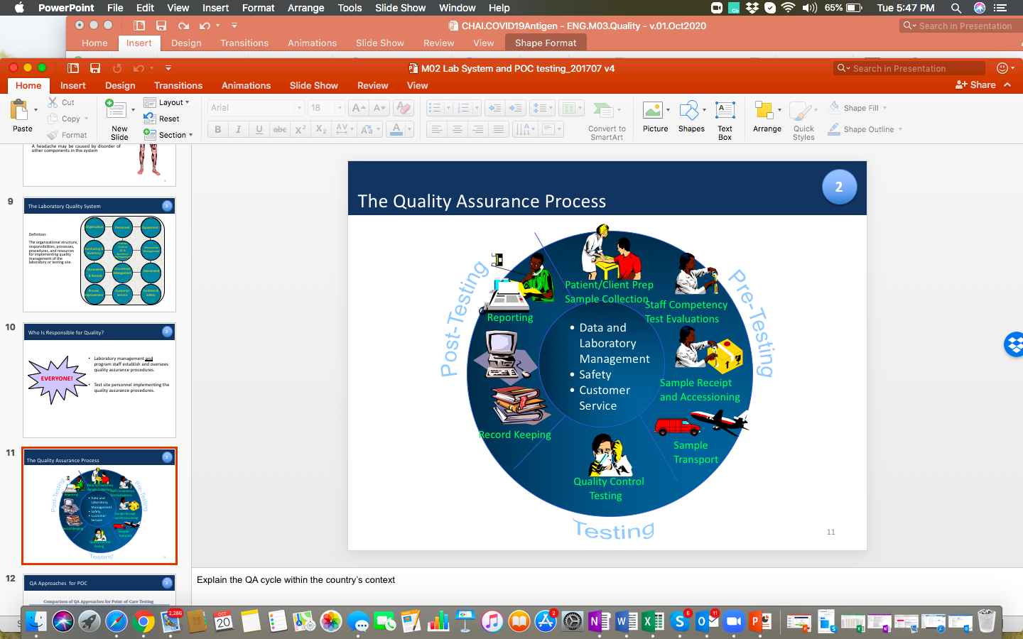
Quality Assurance Introduction
Quality Assurance (QA) is:
  A planned and systematic set of activities that are put in place to ensure that a testing site produces quality results
  A series of planned, step-by-step activities that avoid adverse outcomes by ensuring:
    Testing is being carried out correctly and quickly
    Results are accurate, reliable and timely
    Mistakes are found and corrected in a timely fashion
  Performed by the tester/operator at a testing site
Source: QUALITY ASSURANCE IN SARS-COV-2 ANTIGEN RAPID DIAGNOSTIC TESTING FOR DIAGNOSIS OF COVID-19 by AFENET; SLMTA Quality Assurance module

Slide 3
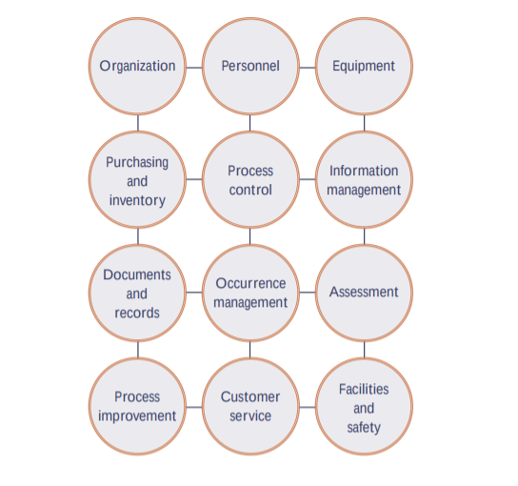
Quality System Essentials
Quality system essentials are:
  A set of coordinated activities that serve as building-blocks for quality management
  A core component of the Site Supervision Assessment Checklist
Address each of the 12 quality system essentials for overall laboratory and testing-site quality and improvements
Source: QUALITY ASSURANCE IN SARS-COV-2 ANTIGEN RAPID DIAGNOSTIC TESTING FOR DIAGNOSIS OF COVID-19 by AFENET; SLMTA Quality Assurance module

Slide 4
Key QA Pillars for COVID Testing
The essential components of QA should be introduced in the following order:
  QC testing
  Supervisory visits
  New lot testing (or new lot verification) of incoming kits
  Proficiency testing

Slide 5
Performing QC
QC is performed by:
  Acquiring 1 positive and 1 negative control sample
    QC materials are often supplied with the COVID-19 Antigen test kit
    Otherwise, QC materials can be purchased, obtained from central or reference laboratories (standardized control materials), or made in-house by pooling specimens from different patients
    Where available, Proficiency Test (PT) samples can also be used as a source of QC materials, using:
      Known positive patient samples as positive control
      Known negative samples (or extraction buffer) as negative control
  Testing samples with known POSITIVE or NEGATIVE results with batches of patient samples
  Analyzing results received, as compared to the expected result (known outcomes)
    If the QC results do not match the expected results, QC has failed
    Investigation (root cause analysis) and corrective action is required
    Furthermore, patient test results cannot be released if QC fails

Slide 6
Performing New Lot Testing
Lot Testing is performed by:
  Obtaining 5+ control (or known) samples (3 positive, 2 negative)
    See recommendations for obtaining samples under “Performing QC”
  Randomly choosing 5 Antigen test kits from each new lot
  Testing samples with known POSITIVE or NEGATIVE results
  Analyzing results received, as compared to the expected result (known outcomes)
    If results for a lot fall outside the expected ranges, the designated lab conducting the lot testing (or the testing site) should:
      Investigate further
      Perform new lot testing
      (potentially) Recall the COVID-19 Antigen test kits from testing sites

Slide 7
External Quality ASSESSMENT
External Quality Assessment (EQA) is:
  A defined set of activities to evaluate performance and operation of a testing site
  Performed through an external source, for objectivity
EQA consists of:
  Supervision visits
  Proficiency testing
  Re-testing

Slide 8
ON-SITE ASSESSMENTS (1)
On-Site Assessments are:
  Follow-up onsite, supervision visits and will be done by national TOTS
  Helpful in facilitating and supporting HCWs in integrating COVID-19 Antigen testing processes into routine patient management and record keeping
  Will be done immediately after the training and every 3 months

Slide 9
ON-SITE ASSESSMENTS (2)
When doing On-Site Assessments, facilities will be checked for:
Sample management
Testing personnel competency
Biosafety & Biosecurity
EQA
(QC & QA)
Data management
Inventory management
Results management
Quality Improvement processes
Documents & Records

Slide 10
Proficiency Testing (1)
The Proficiency Testing (PT) process includes:
  Tester
    Receives well-characterized (known to Reference Lab or PT provider ONLY) samples
    Performs the Antigen testing and analysis
    Reports the results back to the Reference Lab or PT provider (external or internal)
  Reference Lab or PT provider
    Analyzes Tester results against the known results
    Compares Tester results to other testers from the same site (or from different testing sites)
    Reports the outcome back to the tester

Slide 11
Proficiency Testing (2)
COVID-19 Antigen Testers will be enrolled in the PT programme and will regularly receive well-characterized samples for testing
  Currently, there are few external agencies providing characterized SARS-CoV-2 samples for COVID-19 Testers (One World Accuracy, Thistle, etc.)
  In the interim UVRI will facilitate and produce well-characterized samples for testing by COVID-19 Antigen Testers
The tester should,
  Conduct the COVID-19 Antigen test as directed by the PT programme
  Report the results of the PT tests as required
  If feedback indicates incorrect results, investigate and perform corrective action

Slide 12
Re-Testing
Re-testing is:
  Inter-laboratory comparison of results
  When a testing site performing SARs-CoV-2 Ag-testing submits some of the samples it has tested for COVID-19 to other testing sites to check if there is agreement in the results
Like in Proficiency Testing, the results of the testing site are compared against the results from the secondary testing sites, looking for agreement in results
With oversight from designated laboratory, the testing site must:
  Define the frequency of sample re-testing (monthly, quarterly, by country policy)
  Define the proportion of the positive and negative samples to be submitted for re-testing at a specified regular frequency
    At minimum, at least 5% of the positive and 10% of the negative samples should be submitted for re-testing
  Document, record, and investigate all unsuccessful re-testing results
  Take appropriate corrective and preventive actions

Slide 13
TAKING action
Health Care Facilities should take action when:
  Testers fail PT tests
  Supervision visits identify areas of improvement (error trends in the assessment report)
Root Cause Analysis helps determine the reason for the testing error or deficiency
Once identified, the Root Cause must be addressed by taking Corrective Action
Preventative Action prevent reoccurrence of the testing error or deficiency
Document all root cause analysis, corrective action, and preventative action
Root cause
Corrective action
Preventive action

Slide 14
Competency Assessments
After this training exercise, all Testers must perform a Competency Assessment to certify them as proficient at testing samples and reading results
Competency Assessments are conducted using:
  QC materials for COVID-19 testing
  Relevant standardized checklists/tools for competency assessment
Today’s Competency Assessment and the ongoing PT programme both use well-characterized samples for assessing the Tester’s proficiency
  Ongoing PT programme will be performed regularly at the testing site by UVRI

Slide 15
Questions

