Slide 1


Module 07
DIAGNOSTICS AND SUPPLY INVENTORY MANAGEMENT

Slide 2
Supplies & Materials Checklist
Sample collection & transport:
  New (unopened) sterile swab
  PPE (gloves, gown, goggles, face mask N95)
  Pen for marking or labeling
  Specimen triple packaging supplies, where needed
  Appropriate transport media where indicated
COVID-19 Antigen testing:
  COVID-19 test kit
  Alcohol, bleach, bottle, tissues, measuring device to make solution
  Soap for hand washing
  Leak-proof bag for containing or moving labeled biohazard waste
  Waste container
  Pen for marking or labeling
  PPE (gloves, gown, goggles)
  Timer
  Positive and Negative controls
  COVID-19 Antigen Test Logbook
  Standard Operating Procedures
  Thermometer

Slide 3
COVID-19 ANTIGEN TEST KITS
Typical COVID-19 Antigen test kits consists of:
RDT-visual read
Device-Based
  Test (individually wrapped in foil pouch with desiccant)
  Extraction buffer tube
  Nozzle cap
  Sterile swab
  Paper stand
  Instructions for use
  Test strip (individually wrapped in foil pouch with desiccant)
  Extraction Vial
  Dropper Lid
  Instructions for use

Slide 4
Stock Management Introduction
Stock Management is:
  The practice of ordering, storing, tracking, and controlling (antigen testing) inventory
Benefits of proper Stock Management:
  Ensures availability of materials and kits, when needed
  Avoids the use of expired kits → minimizes wastage and uses time wisely
  Leads to uninterrupted testing
Note:
  Stock Management refers to management of testing-related items that will run out or be used up during the testing process.
  Additional considerations should be taken to ensure correct management, storage, and maintenance of long-term assets, like POC-device instruments and phone access.

Slide 5
Stock Management Steps
Stock Management involves knowing:
  What the specifications of supplies and kits areª
  What and how many supplies/consumables you have
  When and how to order
  What and how much stock was ordered (and when)
  Where to store stock
  When and how much fresh stock was received, and by whom
ª Only use tests approved in your country. Ensure that country requirements for sample collection swabs, disinfectants and PPE are followed. Only obtain supplies from reputable suppliers

Slide 6
Stock Management Cycle
Performing stock count
Maintaining proper inventory records
Determining when to re-order
Determining how much to order
Placing orders properly
Inspecting delivery of new orders
Ensuring proper storage of stock

Slide 7
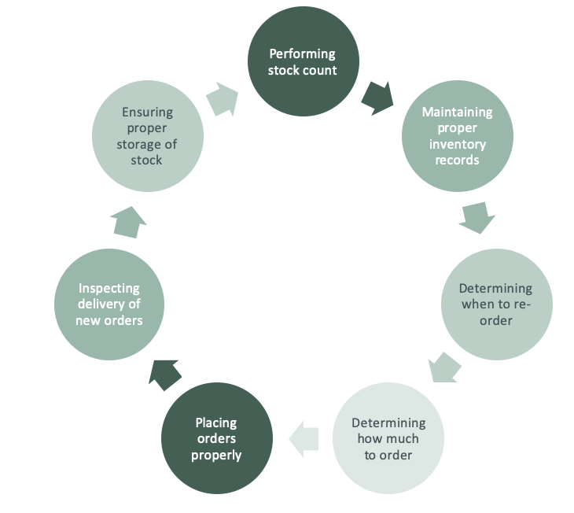
Stock Count
Stock Count is:
  Physically counting each item in the stock
Stock Count is performed:
  (Recommended) at the beginning of each week or month, depending on the established Standard Operating Procedures (SOPs)
  By a designated person in the healthcare facility
Stock Count is important because:
  All items must be accounted for
  Everything that comes in and goes out must be recorded

Slide 8
Maintaining Proper Inventory Records
Inventory Records are important because:
  They are the written register of what is on-hand at the healthcare facility
Stock Cards
  Simple, heavy weight cards
  Kept for each item in stock
  To be filled out by site staff using their own normal stock cards as part of routine in the health facility
Stock Book or Register
  Contains listing of all items in the store
  Update weekly after physical count from information on the stock cards

Slide 9
When to order
Analyze the needs of the facility by making a list of the all the required reagents and supplies:
  A detailed description of each item used for sample collection and testing
  The package count or number of units in which the item is supplied
  Approximate usage per month
  The priority or importance-level for testing
    For example: Is it used every day or only once a month?
  The length of time required to receive a delivery
    For example: Will the order take a day, week, or month to arrive?
  Storage space and conditions
    For example: Will a bulk order use too much storage space? Does it require refrigeration?
The facility must place orders when the stocks are low, not when stock has run out

Slide 10
How to order
Establish a list of supplies to be ordered
Complete a purchase order, and have it approved according to the clinical facility’s procedure
Forward the purchase order to the procurement officer for processing and ordering
The supplies are added to the current inventory and stored according to manufacturer’s instructions
a The mechanism for ordering supplies may need to be adapted to account for central procurement and distribution

Slide 11
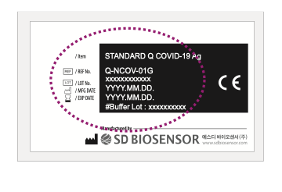
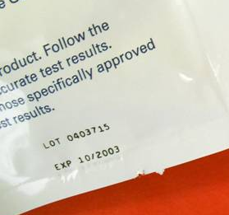
Upon Receipt of New Orders
Inspect delivery of new orders:
  Verify contents of order received with requisition (for accuracy)
  Check integrity of received supplies
    Note any damaged or compromised materials
Update (or create) inventory records:
  Date each item received
  Expiration date
a The mechanism for receiving supplies may need to be adapted to account for central procurement and distribution. E.g. Inform supervisory or central level on any problems with stock received

Slide 12
Ensure Proper Storage of Inventory
Place items on shelves, storing new shipment behind existing shipment
Store according to manufacturer’s instructions (usually 2-30°C)
Record the temperature
Store away from direct sunlight
Keep the storeroom clean, organized, and locked

Slide 13
Managing stock
Label all supplies and reagents with date received and the date first opened
Decide on stock levels based on current knowledge of supply availability and frequency of re-supply
Rotate stock using “First Expired, First Out” (FEFO) principles
  This ensures that out-of-date reagents are not used
  If there are expired reagents, they should be separated, marked “Expired – Do not use”, and then discarded according to manufacturer’s instructions

Slide 14
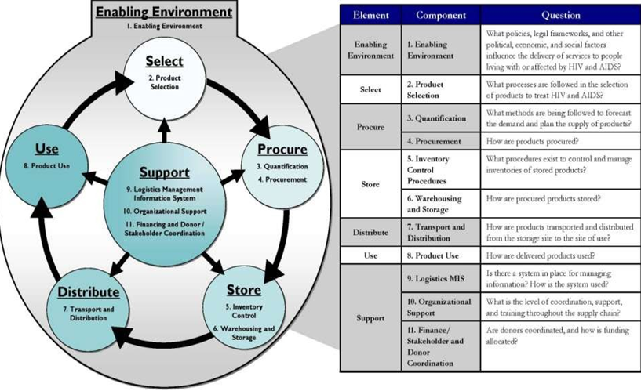
LOGISTICS CYCLE

Slide 15
Questions

