Slide 1
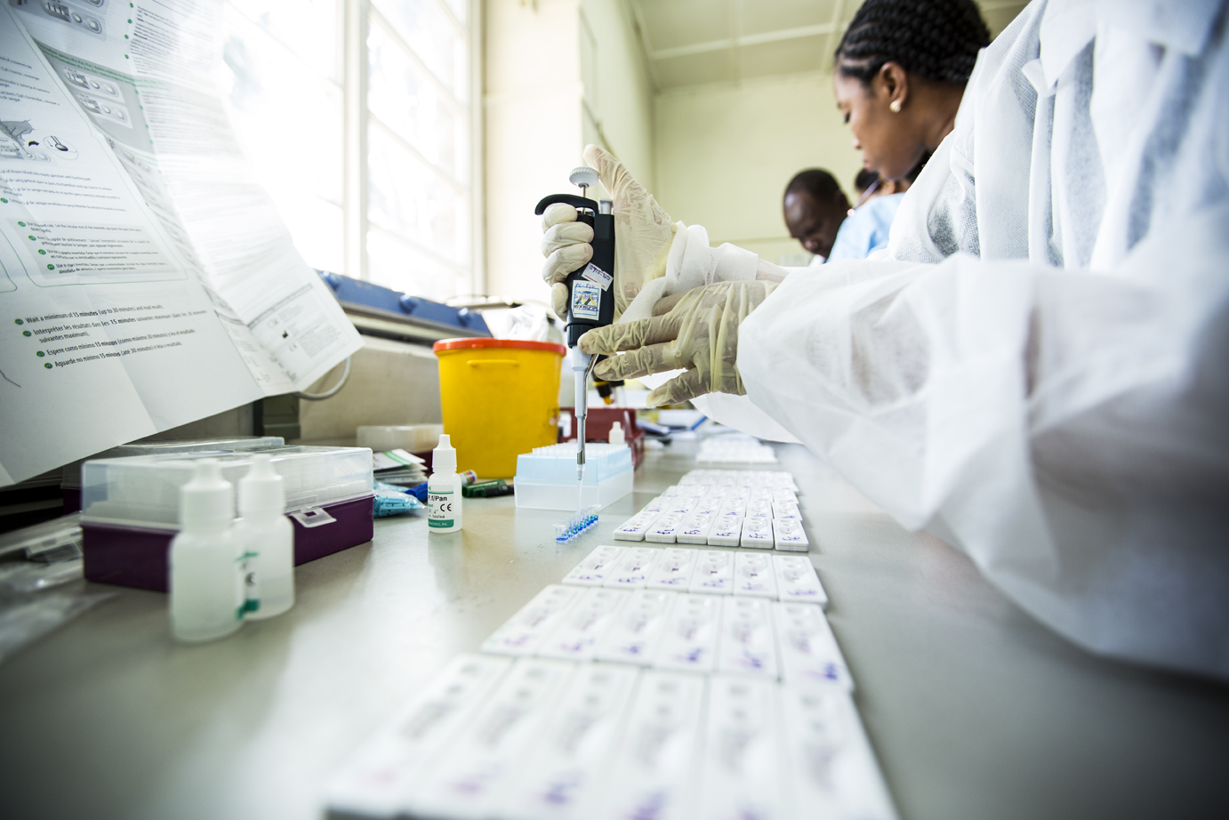






Overview of SARS-COV-2 testing
Module 06
Antigen Testing: General Guidelines
Photo Source: FIND

Slide 2
Learning Objectives
Through this module you will be able to:
  Use rapid antigen tests according to the Instructions for Use
  Accurately interpret individual test results
  Note for TOT: Supplier-specific sample-testing content will be performed live, via in-person or live-stream. Therefore, ENSURE training is SCHEDULED appropriately for distributor presentation for M06 – Antigen Testing.
Photo Source: FIND

Slide 3
Testing General Guidelines
The test procedures and interpretations are similar for all COVID-19 antigen rapid diagnostic tests
It is important to follow the test specific Instructions for Use (IFU), as reagents and procedures (including incubation times) may vary between tests
For all testing kit types:
  Do not re-use the test kit
  Do not use the test kit if the pouch is damaged or the seal is broken
  Do not use the extraction buffer tube of another lot
  Kit materials are stable until the expiration date printed on the outer box
  Do not freeze the kit
  Allow all components to come to room temperature (15-30°C) before use

Slide 4
Before Testing (1)
M.6
Store the test kits properly and away from direct sunlight, according to manufacturer instructions:
  For Standard Q: at 2-30°C
  For Panbio: at 2-30°C up to 12 months
  For LumiraDx: Test strips at 2-30 ̊C
Review type of sample required
  Usually, RDT from a Nasopharyngeal Swab, Device-based from Nasal Swab
Review contents of the test kit, which usually include:
Before
During
After
RDT-visual read
Device-based
  Test device (individually wrapped in foil pouch with desiccant)
  Extraction buffer tube
  Nozzle cap
  Sterile swab
  Paper stand
  Instructions for use
  Test strip (individually wrapped in foil pouch with desiccant)
  Extraction Vial
  Dropper Lid
  Instructions for use

Slide 5
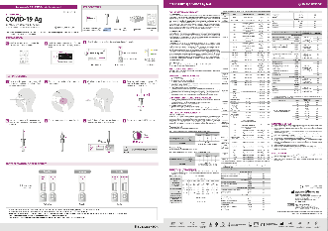
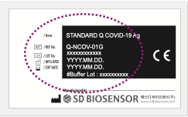
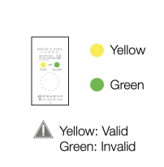
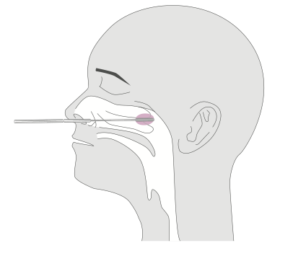
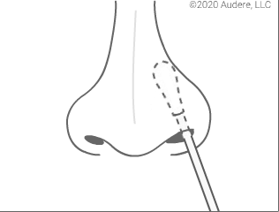
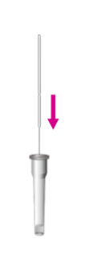
Before Testing (2)
Carefully read instructions for using the test kit
Check the expiry date at the back of the foil pouch
  Do not use the kit, if expiry date has passed
Check the test device and the desiccant pack in the foil pouch
  Do not use if either is damaged or invalid
Correctly label components / data-entry on device
Perform Hand Hygiene, and wear appropriate PPE
Collect swab sample (general Guidelines Module 05)
Insert swab sample directly into extraction buffer tube, according to manufacturer instructions
Test the sample as soon as possible after collection
  Samples may be stored at room temperature for up to 1 hour (according to manufacturer instructions) OR at 2-8°C/ 36-46°F for up to 4 hours prior to testing
Before
During
After
Notes:
Participants can reference M05 Materials - Sample Guidelines

Slide 6
Testing & Interpreting Results
See supplier-specific training content
Before
During
After
Notes:
Participants can use Materials – [Choose Appropriate Supplier] Reference Guide.pdf for reference

Slide 7
After Testing
After Antigen testing, a healthcare worker should:
Record the test result in the COVID-19 Antigen Testing Logbook
Dispose of all waste (used test kit, extraction buffer tube, swab and paper stand) in the biohazard bag
Properly remove PPE, and do hand hygiene
Report the result
Before
During
After

Slide 8
Activity A: Workstation Setup
Purpose: Properly prepare for testing
Instructions:
  Use reference materials to support
    M04 Materials - Workstation Prep handout
    M05 Materials – Sample Guidelines handout
    M06 Materials – [Supplier-specific] Reference Guide.pdf
  Gather all necessary supplies
  Gather control samples from your instructor
  Properly arrange all items at your workstation
Activity Time: 5 min
Notes:
Activity (5 min)
Participants can use Materials – [Choose Appropriate Supplier] Reference Guide.pdf for reference
Participants can reference M04 Materials – Workstation Prep
Participants can reference M05 Materials - Sample Guidelines
Materials:
Test kits (1 each)
Positive control samples (1 each)
Negative control samples (1 each)
Supplies
Polyester fiber-tipped swab or Flocked nylon swab
Extraction buffer tube
Biohazard bags
Marker or pen
Tissue paper
Alcohol based hand rub (e.g. 70% alcohol)
Disinfectant (e.g. 10% bleach)

Slide 9
Activity B: Examine Test Kits
Purpose: Examine test kits used in-country
Instructions:
  Open test kit
  Examine the different components found in each of the COVID-19 Antigen test kits
  Note: Buffer solution is required by some kits
  Note: the desiccant packet is not used when performing the test
    It only serves to keep the packet contents dry before use
    It should be discarded when the test kit packet is opened
Activity Time: 5 min
Notes:
Activity (5 min)
Materials:
Test kits (1 each)
EXPLAIN: Next, you will examine the contents of a test kit
INVITE participants to DIVIDE into pairs.
EXPLAIN the instructions:
OPEN the test kit
EXAMINE the different components found in each of the COVID-19 Antigen test kits
GIVE each pair a test kit.
ALLOW 5 minutes.

Slide 10
Activity C: Testing Practice
Purpose: Properly conduct COVID-19 Antigen testing
Instructions:
  Use reference materials to support
    M04 Materials - Workstation Prep handout
    M05 Materials – Sample Guidelines handout
    M06 Materials – [Supplier-specific] Reference Guide.pdf
  Use safety precautions
  Perform two COVID-19 Antigen tests with control samples (from instructor)
  Show your test results to instructor after you finish
Activity Time: 25 min
Notes:
Activity (25 min)
Participants can use Materials – [Choose Appropriate Supplier] Reference Guide.pdf for reference
Participants can reference M04 Materials – Workstation Prep
Participants can reference M05 Materials - Sample Guidelines
Materials:
Test kits (1 each)
Positive control samples (1 each)
Negative control samples (1 each)
Supplies
Polyester fiber-tipped swab or Flocked nylon swab
Extraction buffer tube
Biohazard bags
Marker or pen
Tissue paper
Alcohol based hand rub (e.g. 70% alcohol)
Disinfectant (e.g. 10% bleach)

Slide 11
Activity D: Interpreting Results
Purpose: Properly interpret results of COVID-19 Antigen testing
Instructions:
  Use reference materials to support
    M04 Materials - Workstation Prep handout
    M05 Materials – Sample Guidelines handout
    M06 Materials – [Supplier-specific] Reference Guide.pdf
  Interpret the test results from the COVID-19 Antigen test
  Show diagnoses to instructor after you finish
Activity Time: 5 min
Notes:
Activity (5 min)
Participants can use Materials – [Choose Appropriate Supplier] Reference Guide.pdf for reference
Participants can reference M04 Materials – Workstation Prep
Participants can reference M05 Materials - Sample Guidelines
Materials:
Test kits (1 each)
Positive control samples (1 each)
Negative control samples (1 each)
Supplies
Polyester fiber-tipped swab or Flocked nylon swab
Extraction buffer tube
Biohazard bags
Marker or pen
Tissue paper
Alcohol based hand rub (e.g. 70% alcohol)
Disinfectant (e.g. 10% bleach)

Slide 12
Questions

