Slide 1

Module 04
SAFETY AND INFECTION PREVENTION CONTROL

Slide 2

Infection, Prevention and Control (IPC)
Infection, Prevention and Control (IPC) is:
  Steps and systems for preventing harm (caused by infections) to patients and healthcare workers
  Grounded in principles of infectious disease, epidemiology, social science, and health system strengthening
  Rooted in patient safety and health service quality
Good IPC recognizes that everyone is at risk of infection
Graphic source: Managing epidemics: key facts about major deadly diseases. Geneva: World Health Organization; 2018. Licence: CC BY-NC-SA 3.0 IGO.

Slide 3
COVID-19 Transmission Management
To prevent transmission of infection, practice the following precautions:
  Direct Contact precautions: Avoid touching (without proper PPE) another person or any contaminated object or surface, including body fluids:
    Blood, Saliva/sputum, Nasal discharges, Wound drainage, Urine, Feces/Stool
  Indirect Contact precautions: Avoid touching (without proper PPE) any contaminated object or surface, including:
    Used tissues, Contaminated equipment (anything invasive, in contact with mucous membrane, or in contact with non-intact skin), Other objects in contact with secretion
  Droplet precautions: Avoid (without proper PPE) droplet sprays directly or in contact with contaminated surfaces
    Droplets can contaminate directly (through person-to-person contact with hands, nasal droplets, throat droplets)
    Droplets can contaminate indirectly (through object-to-person contact with bed pans, urinals, dressing trolleys, mattresses, drip stands, mops and buckets, etc.)

Slide 4
WHO Strategies for IPC in COVID-19
The World Health Organization (WHO) has recommended IPC strategies to prevent/limit transmission in the health care setting:
  Applying Standard Precautions for all patients
  Ensuring triage, early recognition and source control
  Implementing empiric additional precautions for suspected cases of COVID-19 infection
  Implementing administrative controls
  Using environmental and engineering controls

Slide 5
#1 Standard Precautions for COVID-19:
Overview
WHO Strategy #1 - Standard Precautions are the basic level of infection prevention precautions for ALL patients at ALL times:
  Whenever providing patient care, regardless of the patient’s diagnosis
  Avoiding unprotected contact with body fluids (blood, respiratory secretions, excretions)
  For all contact with body fluids regardless of the infection status
  Minimizing and preventing spread of infection to healthcare workers, other patients, and visitors
Standard Precautions assume every person is potentially infected and potentially transmitting
Standard Precautions, in the context of COVID-19 include:
Hand Hygiene
Cough Etiquette
Protective Clothing
Clean Environment
Clean Equipment
Waste Management
Patient Flow
Sharp Safety
Safe Injection Practices
Handle Linen Correctly
Occupational Health

Slide 6
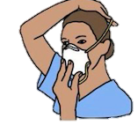
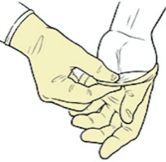



#1 Standard Precautions for COVID-19:
Hand Hygiene (2)
Hand hygiene is the single most important procedure for preventing the spread of biological contamination or acquiring infection
Hand hygiene should be performed in all 5 “moments”:
  Before putting on PPE and after removing it
  When changing gloves
  After any contact with patient with suspected or confirmed COVID-19 infection or their waste
  After contact with any respiratory secretions
  Before eating and after using the toilet
Hand Hygiene
Cough Etiquette
Protective Clothing
Clean Environment
Clean Equipment
Waste Management
Patient Flow
Sharp Safety
Safe Injection Practices
Handle Linen Correctly
Occupational Health

Slide 7


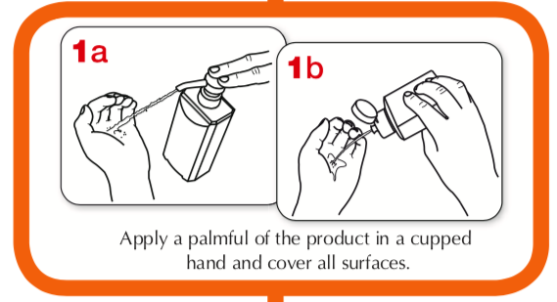
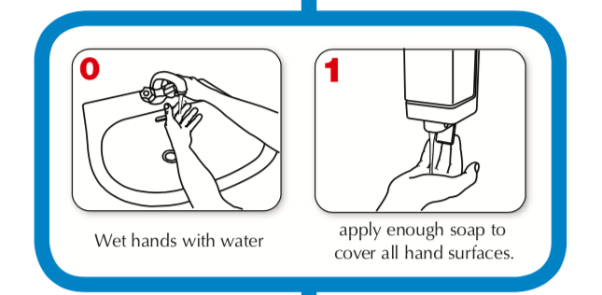
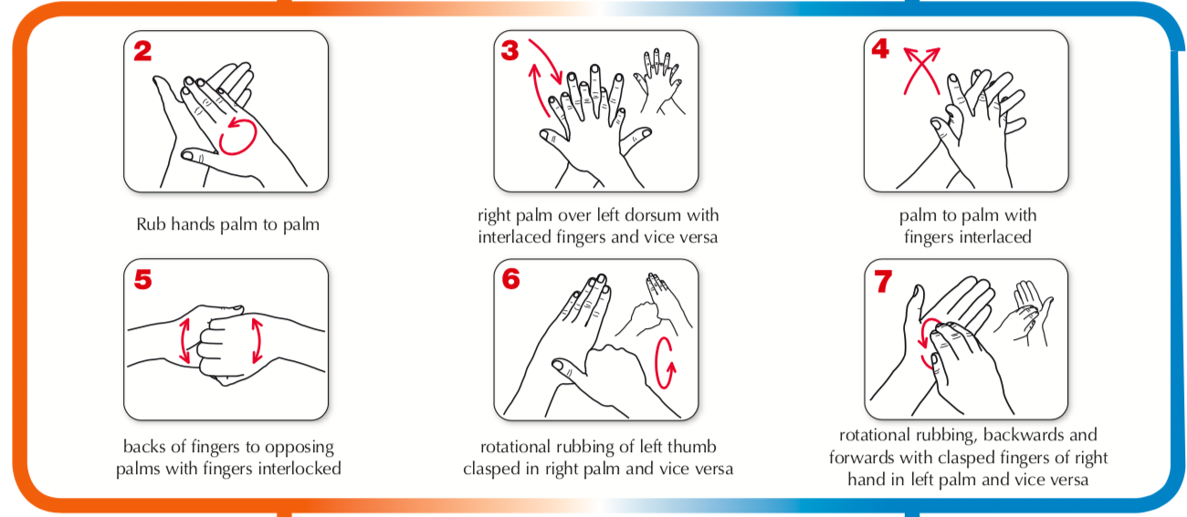
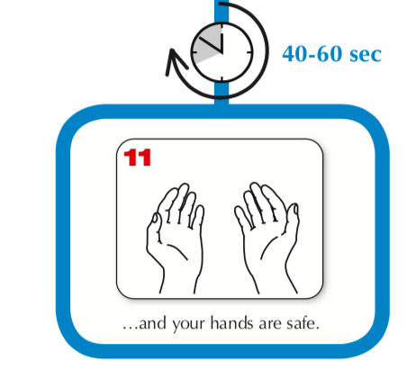
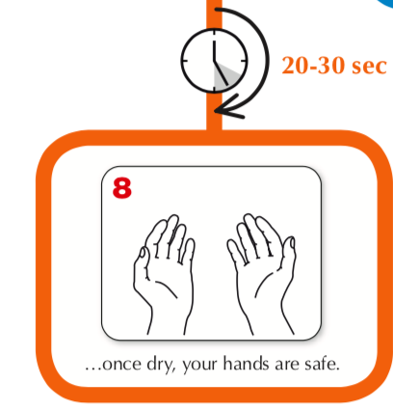
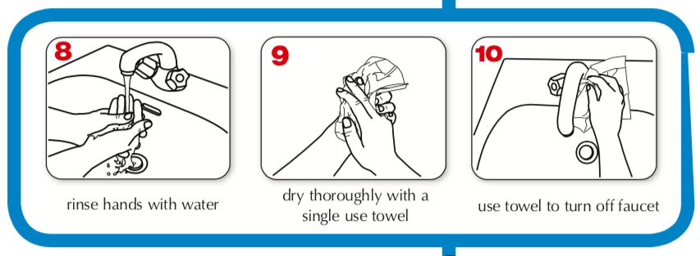
#1 Standard Precautions for COVID-19:
Hand Hygiene (3)
Hand Hygiene
Cough Etiquette
Protective Clothing
Clean Environment
Clean Equipment
Waste Management
Patient Flow
Sharp Safety
Safe Injection Practices
Handle Linen Correctly
Occupational Health
Notes:
Participants can use their Materials - Hand Wash Instructions for reference.

Slide 8
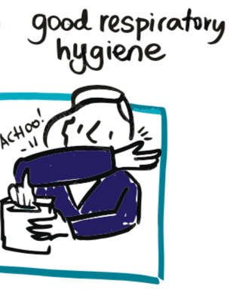
#1 Standard Precautions for COVID-19:
Cough Etiquette
Cough Etiquette includes:
  Turning head away from others when coughing or sneezing
  Covering nose and mouth when coughing or sneezing
  Coughing into elbow flexure or tissue
  Discarding disposable tissue in waste containers
  Performing hand hygiene after contact with respiratory secretions or contaminated objects
  Seating coughing persons outside or away from others (minimum 1m) in common waiting areas
  Providing masks and tissues for patients
Hand Hygiene
Cough Etiquette
Protective Clothing
Clean Environment
Clean Equipment
Waste Management
Patient Flow
Sharp Safety
Safe Injection Practices
Handle Linen Correctly
Occupational Health

Slide 9
#1 Standard Precautions for COVID-19:
PPE (1)
Personal Protective Equipment (PPE) are specialized clothing or equipment worn for protection against infectious materials
Hand Hygiene
Cough Etiquette
Protective Clothing
Clean Environment
Clean Equipment
Waste Management
Patient Flow
Sharp Safety
Safe Injection Practices
Handle Linen Correctly
Occupational Health
Source: CDC, Coronavirus infectious control Guidance, April 13, 2020
Notes:
Participants can use their Materials – PPE Overview handout for reference.

Slide 10
#1 Standard Precautions for COVID-19:
PPE (2)
Necessary PPE: Gowns
  Outer garments that are easy to put on and to take off
Best Practices:
  Wear gowns when handling infectious materials
  Put on a clean gown/apron upon contact with patient or entering working area for sample collection
  Change the gown if it becomes soiled
  Remove and discard the gown in a dedicated container for waste or linen before leaving the care area or the lab
  Disposable gowns should be discarded after use. Cloth gowns should be laundered after each use.
Hand Hygiene
Cough Etiquette
Protective Clothing
Clean Environment
Clean Equipment
Waste Management
Patient Flow
Sharp Safety
Safe Injection Practices
Handle Linen Correctly
Occupational Health
Source: CDC, Coronavirus infectious control Guidance, April 13, 2020
Notes:
Participants can use their Materials – PPE Overview handout for reference.

Slide 11
#1 Standard Precautions for COVID-19:
PPE (3)
Necessary PPE: Respirator or Face Mask
  Medical device covering the mouth, nose and chin
  Ensures a barrier that limits the transition of an infective agent
Best Practices:
  Before putting on a mask, clean hands with alcohol-based hand rub or soap and water
  Cover mouth and nose with mask and make sure there are no gaps between your face and the mask
  Avoid touching the mask while using it; if you do, clean your hands with alcohol-based hand rub or soap and water
  Replace the mask with a new one as soon as it is damp
  Do not re-use single-use masks
  To remove the mask: remove it from behind (without touching front of mask); discard immediately in a closed bin; clean hands with alcohol-based hand rub or soap and water
Hand Hygiene
Cough Etiquette
Protective Clothing
Clean Environment
Clean Equipment
Waste Management
Patient Flow
Sharp Safety
Safe Injection Practices
Handle Linen Correctly
Occupational Health
Source: CDC, Coronavirus infectious control Guidance, April 13, 2020
Notes:
Participants can use their Materials – PPE Overview handout for reference.

Slide 12
#1 Standard Precautions for COVID-19:
PPE (4)
Necessary PPE: Goggles or Face Shield
  Protection for face, mouth, nose, and eyes against splashes, sprays, and respiratory droplets
Best Practices:
  Wear when performing activities likely to generate splashes or sprays of blood, body fluids, secretions, or excretions
  Remove eye protection before leaving the patient or care area or the lab
  Reusable eye protection (e.g., goggles) must be cleaned and disinfected according to manufacturer’s reprocessing instructions prior to re-use
  Disposable eye protection should be discarded after use unless following protocols for extended use or reuse
Hand Hygiene
Cough Etiquette
Protective Clothing
Clean Environment
Clean Equipment
Waste Management
Patient Flow
Sharp Safety
Safe Injection Practices
Handle Linen Correctly
Occupational Health
Source: CDC, Coronavirus infectious control Guidance, April 13, 2020
Notes:
Participants can use their Materials – PPE Overview handout for reference.

Slide 13
#1 Standard Precautions for COVID-19:
PPE (5)
Necessary PPE: Gloves
  Non-sterile, disposable patient-examination gloves
Best Practices:
  Put on clean, non-sterile gloves upon entry into care area or contact with patient
  Change gloves if they become torn or heavily contaminated
  Avoid touching face or adjusting PPE with contaminated gloves
  Avoid touching environmental surfaces, except as necessary during patient care
  Never wash or reuse disposable gloves
  Put on gloves last when using a combination of PPE
  Remove and discard gloves when leaving the care area
  Once removed, immediately perform hand hygiene
  Discard used gloves in appropriate biohazard bin
Hand Hygiene
Cough Etiquette
Protective Clothing
Clean Environment
Clean Equipment
Waste Management
Patient Flow
Sharp Safety
Safe Injection Practices
Handle Linen Correctly
Occupational Health
Source: CDC, Coronavirus infectious control Guidance, April 13, 2020
Notes:
Participants can use their Materials – PPE Overview handout for reference.

Slide 14

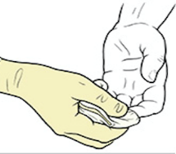
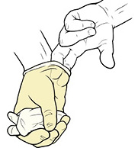
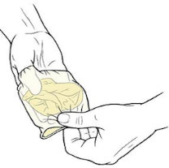
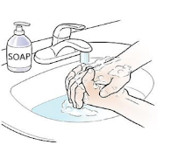
#1 Standard Precautions for COVID-19:
PPE (6)
Necessary PPE: Gloves
  Non-sterile, disposable patient-examination gloves
How to safely remove gloves:
  Grasp the palm of one glove near your wrist, and carefully pull the glove off, turning it inside out
  Hold the glove in the palm of the still-gloved hand
  Slip two fingers under the wrist of the remaining glove
  Pull the second glove until comes off inside out
    The first glove should end up inside the glove you just took off
  Dispose of the gloves safely and wash your hands after removing gloves and before touching any objects or surfaces
Hand Hygiene
Cough Etiquette
Protective Clothing
Clean Environment
Clean Equipment
Waste Management
Patient Flow
Sharp Safety
Safe Injection Practices
Handle Linen Correctly
Occupational Health
Source: CDC, Coronavirus infectious control Guidance, April 13, 2020
Notes:
Participants can use their Materials – PPE Overview handout for reference.

Slide 15

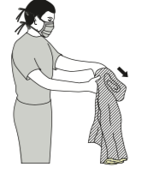

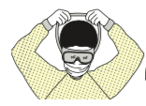

#1 Standard Precautions for COVID-19:
PPE (7)
Safely remove PPE without contaminating your clothing, skin, or mucous membranes with potentially infectious materials
Sequence of PPE removal:
  Gloves: Remove gloves carefully with appropriate technique. Dispose of them safely.
  Gown: Unfasten ties, then peel gown away from neck and shoulder. Turn contaminated outside toward the inside. Fold or roll into a bundle and discard.
  Perform Hand Hygiene
  Face shield or goggles: Remove eye protection by pulling the string from behind the head and disposed of it safely.
  Face mask: Grasp bottom ties or elastics of the mask/respirator, then grasp the ones at the top. Remove without touching the front.
  Perform Hand Hygiene
Hand Hygiene
Cough Etiquette
Protective Clothing
Clean Environment
Clean Equipment
Waste Management
Patient Flow
Sharp Safety
Safe Injection Practices
Handle Linen Correctly
Occupational Health
Source: CDC, Coronavirus infectious control Guidance, April 13, 2020
Notes:
Participants can use their Materials – PPE Don Doff handout for reference.

Slide 16
#1 Standard Precautions for COVID-19:
Clean Environment (1)
Cleaning and disinfection ensure infection control, as contaminated surfaces can transmit infectious agents
Decontamination: process that removes soil and pathologic microorganisms from objects so they are safe to handle
Best Practices:
  Clean the area first: Use soap or mild detergent and water to physically remove contamination by foreign materials
  Then, disinfect: Use chemicals to kill bacteria and some viruses, reducing the number of viable microorganisms to a less harmful level
Hand Hygiene
Cough Etiquette
Protective Clothing
Clean Environment
Clean Equipment
Waste Management
Patient Flow
Sharp Safety
Safe Injection Practices
Handle Linen Correctly
Occupational Health

Slide 17
#1 Standard Precautions for COVID-19:
Clean Environment (2)
In case of a bodily-fluid spill:
  Wear gloves and gown
  Flood the spill area with 1% bleach
  Cover the spill and disinfectant with paper towel
  Leave the spill and disinfectant with paper towel (10+ minutes)
  Wipe up the spill, disinfectant, and paper towel
    Discard in the biohazard waste
  Disinfect (again) the area with 1% bleach and dry with paper towel
    Discard the paper towel in the biohazard waste
  Disinfect the area with 70% ethanol alcohol and dry with paper towel
    Discard the paper towel in the biohazard waste
Hand Hygiene
Cough Etiquette
Protective Clothing
Clean Environment
Clean Equipment
Waste Management
Patient Flow
Sharp Safety
Safe Injection Practices
Handle Linen Correctly
Occupational Health

Slide 18
#1 Standard Precautions for COVID-19:
Clean Equipment
Cleaning and disinfection ensure infection control, as contaminated equipment can transmit infectious agents
Best Practices:
  Use dedicated medical equipment with known or suspected COVID-19 cases
  Clean and disinfect all non-dedicated, non-disposable medical equipment between each use
    Currently, WHO recommends: 70% ethyl alcohol to disinfect between uses, such as reusable dedicated equipment (e.g.: thermometers)
  Ensure routine cleaning and disinfection procedures
  Manage laundry, food service utensils, and medical waste in accordance with routine procedures (including PPE)
  Cleaners or housekeeping should wear appropriate PPE when cleaning an isolation room or area
Note: Do NOT spray disinfectant on device-based tests¹
Hand Hygiene
Cough Etiquette
Protective Clothing
Clean Environment
Clean Equipment
Waste Management
Patient Flow
Sharp Safety
Safe Injection Practices
Handle Linen Correctly
Occupational Health
1 Follow manufacturer instructions

Slide 19
#1 Standard Precautions for COVID-19:
Making Disinfectant Solutions
1% Bleach | Sodium hypochlorite
70% Ethanol
Hand Hygiene
Preparation:
  Use a suitable container / spray bottle
  Add 20ml of household bleach to 80ml of water
  Label with the name of the disinfectant (1% Bleach) and the date of preparation
  Prepare the diluted bleach disinfectant daily
Usage:
  Can be used to soak items and disinfect spills
  Contact Time: 10–15 minutes
  Corrosive to metals and plastics
Preparation:
  Use a suitable container / spray bottle
  Add 70ml of 100% ethanol to 30ml of water
  Label with the name of the disinfectant (70% Ethanol) and the date of preparation
Usage:
  Ethanol may be stored the container / spray bottle
  Contact Time: 10–15 minutes
  Leaves no residue. Use with other disinfectants to decontaminate surfaces (including metals)
Cough Etiquette
Protective Clothing
Clean Environment
Clean Equipment
Waste Management
Patient Flow
Sharp Safety
Safe Injection Practices
Handle Linen Correctly
Occupational Health
Notes:
Participants can use their Materials - Workstation Prep handouts for reference.

Slide 20
#1 Standard Precautions for COVID-19:
Disinfecting Frequency
Identify and clean/disinfect frequently-touched surfaces:
  Bed rails, drip stand
  Bed side cupboards
  Toilets
  Sink or water basins
  Common patient equipment
  Computer keyboards, telephone/mobile
  Note: Do NOT spray disinfectant on device-based tests
Monitor factors, clean/disinfect more frequently if:
  Close proximity to patient
  Patient’s hygiene level is poor
  Environmental contamination is high
  Patient population requires
Hand Hygiene
Cough Etiquette
Protective Clothing
Clean Environment
Clean Equipment
Waste Management
Patient Flow
Sharp Safety
Safe Injection Practices
Handle Linen Correctly
Occupational Health
1 Follow manufacturer instructions

Slide 21
#1 Standard Precautions for COVID-19:
Waste management (1)
Proper waste management:
  Reduces the potential hazard posed by healthcare waste
  Protects public health and the environment
Handle all waste from COVID-19 sample collection and testing as biohazardous. Currently no evidence to suggest that:
  COVID-19 waste needs any additional packaging or disinfection procedures
  Direct, unprotected human contact during waste handling has resulted in transmission of the COVID-19 virus
Best Practices:
  Treat materials as health and environmental hazards
  Properly dispose of residues either onsite or off-site
  Follow the written policy and SOPs for managing waste
  Wear appropriate PPE, and perform hand hygiene
Hand Hygiene
Cough Etiquette
Protective Clothing
Clean Environment
Clean Equipment
Waste Management
Patient Flow
Sharp Safety
Safe Injection Practices
Handle Linen Correctly
Occupational Health

Slide 22
#1 Standard Precautions for COVID-19:
Waste management (2)
COVID-19 antigen tests are single-use, meaning no components may be reused
Hand Hygiene
Cough Etiquette
At the Health Facility
In the community
Protective Clothing
Place the contaminated material (such as used specimen containers, transfer pipettes, and used tests) in a biohazard bag
At the end of the day, seal the biohazard bag, autoclave or incinerate
Consult facility environmental waste policy regarding proper disposal of unused reagents and biohazard waste
Collect adequate number of biohazard bags before leaving the health facility for community testing
Place the contaminated material in a biohazard bag and seal the bag
Use a new (unused) biohazard bag between different locations in the community
Return the sealed biohazard bags to the health facility for autoclaving and incineration
Clean Environment
Clean Equipment
Waste Management
Patient Flow
Sharp Safety
Safe Injection Practices
Handle Linen Correctly
Occupational Health

Slide 23
#1 Standard Precautions for COVID-19:
Patient Flow (1)
COVID-19 Antigen testing must be performed on a dedicated workstation, separated from the sample collection area and other clinical activities
  The workstation should have restricted access to patients
  Only give workstation access to staff who have been trained in conducting testing
Hand Hygiene
Cough Etiquette
Protective Clothing
Clean Environment
Clean Equipment
Waste Management
Patient Flow
Sharp Safety
Safe Injection Practices
Handle Linen Correctly
Occupational Health

Slide 24
#1 Standard Precautions for COVID-19:
Patient Flow (2)
Workstation: RDT
Workstation: Device-based
Supplies
Hand Hygiene
Waste and disinfectants
(1% Bleach & 70% Ethanol)
COVID-19 Antigen Testing Logbook
Cough Etiquette
COVID-19 test
Timer
Gloves
Protective Clothing
Clean Environment
Clean Equipment
Waste Management
Testing done here
Supplies
Patient Flow
Waste and surface disinfectants
(1% Bleach & 70% Ethanol)
COVID-19 Antigen Testing Logbook
Sharp Safety
COVID-19 POC device
Gloves
Safe Injection Practices
Handle Linen Correctly
180º
Occupational Health
Outlet Access
Level Surface
Testing done here
Notes:
Participants can use their Materials - Workstation Prep handouts for reference.

Slide 25
#1 Standard Precautions for COVID-19:
Patient Flow (3)
Patients who enter the health care facility have the potential to carry the COVID-19 virus and spread it to others
Set up health care facilities with:
  1 meter (minimum) distance between staff and the patient
  Waiting room chairs at 1-meter (minimum) distance
  Space outside for visitors to wait (to prevent overcrowding)
  One way flow, meaning:
    One-way directions for walking around the space
    Each hallway or area should have only one entrance and only one exit
    Patients and staff both follow
Hand Hygiene
Cough Etiquette
Protective Clothing
Clean Environment
Clean Equipment
Waste Management
Patient Flow
Sharp Safety
Safe Injection Practices
Handle Linen Correctly
Occupational Health
Notes:
Participants can use their Materials - Workstation Prep handouts for reference.

Slide 26
WHO Strategies for IPC in COVID-19
The World Health Organization (WHO) has recommended IPC strategies to prevent/limit transmission in the health care setting:
  Applying Standard Precautions for all patients
  Ensuring triage, early recognition and source control
  Implementing empiric additional precautions for suspected cases of COVID-19 infection
  Implementing administrative controls
  Using environmental and engineering controls

Slide 27
#2 Triage (1)
Triage means:
  A quick assessment of patient condition and testing urgency
  Screening to assign an order for patient treatment
  Note: triage is not the same as taking a clinical history or making a diagnosis
Clinical triage in the health care facility helps:
  Identify high-likelihood COVID-19 cases
  Identify (quickly, early) patients with Acute Respiratory Infection (ARI)
  Prevent the transmission of pathogens to healthcare workers or other patients
Triage should be quick and efficient

Slide 28
#2 Triage (2)
Screening areas should have the following:
  Screening questionnaires
  Triage algorithm
  Documentation (clear communication)
  PPE (hand hygiene equipment)
  Infrared thermometers
  Waste bin
  Access to cleaning/disinfectant solutions
  Clear signage in public areas (to instruct patients)
Patients seeking care at Health Facility approach triage station
Assess the patient: History of ARI symptoms?
current fever
difficulty breathing
fever in past 14 days
Yes
No
Does the patient meet current case definition for a suspect for COVID-19?
Yes
No
Patient to holding/isolation room
Collect sample for testing
Test sample
Confirm (or reject) diagnosis
Refer patient for other services
Consider for other diagnosis
Notes:
Participants can use their Materials – Triage handouts for reference.
Participants can use their Materials – Site Safety Poster handouts for reference.

Slide 29
WHO Strategies for IPC in COVID-19
The World Health Organization (WHO) has recommended IPC strategies to prevent/limit transmission in the health care setting:
  Applying Standard Precautions for all patients
  Ensuring triage, early recognition and source control
  Additional precautions for suspected cases of COVID-19 infection
  Implementing administrative controls
  Using environmental and engineering controls

Slide 30
#3 Additional Precautions (1)
Apply all standard precautions, as well as:
Apply contact and droplet precautions for all suspected/confirmed cases
Prepare special accommodation / isolation spaces:
  Single room, door closed, space between bed, adequate ventilation (like: open window or fan)
  Isolation sign on door with patient and health care staff instructions
  Isolation trolley with PPE and hand disinfectant
  Dedicated bathroom or toilet facilities
  All patients with respiratory illness should be in a single room, or minimum 1m away from other patients when waiting for a room
Dedicate equipment and administer additional cleaning/disinfecting
  Use single-use equipment when possible
  Otherwise use equipment dedicated to the patient, and disinfect between uses

Slide 31
#3 Additional Precautions (2)
A team of HCW should be dedicated to care exclusively for suspected patients
  HCW to wear PPE: a medical mask, goggles or face shield, gown, and gloves
  Hand hygiene should be done at each of the WHO “5 Moments”
  Hand hygiene before PPE and after removing PPE
Limit / avoid transport and movement outside the room to only medically essential purposes
  If transportation is necessary, patients to wear masks. HCW to wear appropriate PPE.
  Limit the number of HCW, visitors, and family members in contact with the patient. Everyone must wear PPE if visitation is necessary.
  All persons entering the patient’s room (including visitors) to be recorded (contact tracing)
Use good communication between all health workers and staff caring for patients
Precautions should continue until the patient is asymptomatic

Slide 32
WHO Strategies for IPC in COVID-19
The World Health Organization (WHO) has recommended IPC strategies to prevent/limit transmission in the health care setting:
  Applying Standard Precautions for all patients
  Ensuring triage, early recognition and source control
  Additional precautions for suspected cases of COVID-19 infection
  Implementing administrative controls
  Using environmental and engineering controls

Slide 33
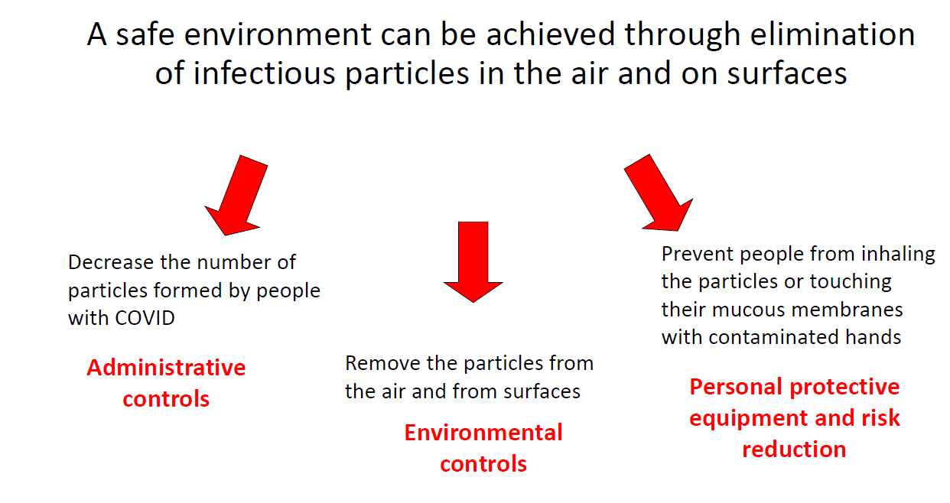
#4 & #5 Administrative, engineering & environmental Controls
Administrative Controls
  Policies and procedures based on sound epidemiological and best practices
  Education and trainings
Engineering and Environmental Controls
  Isolation facilities (patient flow) with appropriate ventilation systems
  Private room or cohorting with signage indicating isolation requirements
  Dedicated toilet
  Dedicated equipment and Disinfection room
  Access to hand washing stations
  Infrastructure to contain spread
Personal Protective Equipment (PPE)
  Gown/Apron, Mask, Goggles/face shield, Disposable gloves
Source: Malawi Epidemiology module extracted from RSA COVID Training

Slide 34
Safety Summary
Review safety precautions throughout the testing process
 | Sample Collection | Testing | Post-Test
Hand Hygiene (HH) | HH before AND after SC: Soap/water 40sec –OR– Alcohol-based rub 20sec | HH before AND after testing: Soap/water 40sec –OR– Alcohol-based rub 20sec | HH before AND after test: Soap/water 40sec –OR– Alcohol-based rub 20sec
Protective Clothing | All PPE: gown, mask, goggles/face shield, gloves | Testing-only PPE: gown, mask, gloves | Remove PPE: gloves, gown, (HH), goggles, mask, (HH)
Clean Environment | If spill: clean soap/water Disinfect bleach / ethanol | If spill: clean soap/water Disinfect bleach / ethanol | Clean & Disinfect workstation
Clean Equipment | Use NEW test kit Use sanitized, dedicated equipment | Use testing materials from NEW test kits | Clean & Disinfect equipment* Remove any single-use material
Waste Management | All materials to biohazard bag |  | All testing supplies to biohazard bag
Patient Flow | Keep patient 1m from others in dedicated room | Keep patient 1m from others in dedicated room | Keep patient 1m from others in dedicated room
* Do NOT spray disinfectant on the device based test – Follow manufacturer instructions

Slide 35
Questions

