Slide 1

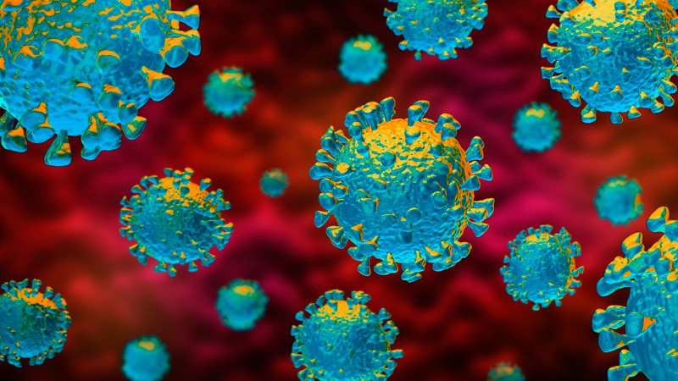
Module 03
COVID-19 FACILITY-BASED SURVEILLANCE

Slide 2
What is public health surveillance?
The continuous, systematic collection, analysis and interpretation of health-related data needed for the planning, implementation, and evaluation of public health practice
The continuous, systematic collection, analysis and interpretation of health-related data needed for the planning, implementation, and evaluation of public health practice
Looking for cases of disease
in a planned
and ongoing manner
and then using the data to do something that makes a difference
Notes:
What is public health surveillance? Textbooks and public health classes will tell you that it’s’ the continuous, systematic collection, analysis and interpretation of health-related data needed for the planning, implementation, and evaluation of public health practice. ‘
But that’s a very jargon-heavy definition! It’s complete, but it’s one that very few people will appreciate the first time they hear it. So how can we boil it down to its key components? Let’s look at it phrase by phrase.
[CLICK] First, the collection and analysis of health-related data. If we were using plain English, that would just mean ‘Looking for cases of disease!’
[CLICK] Second, what is meant by ‘systematic’? It just means ‘in a planned way’. That means we aren’t just looking randomly, but that we have a plan for how we look, so that we can make sure that we know the meaning of what we find.
[CLICK] What does ‘continuous’ mean? It means we do it continuously. That’s what makes surveillance different from a survey! We are looking for cases of disease in a planned and continuous way, instead of looking once and reporting on what we find. That’s a survey.
[CLICK] The rest of this is honestly just jargon. It can best be summarized by saying ‘and using the data to do something that makes a difference!’. This last part is really key. There’s no point in collecting surveillance data if we are going to keep it to ourselves, or not use it to make public health better, right?

Slide 3
What is ‘facility-based surveillance’ for COVID-19?
Active surveillance that occurs in health facilities with the purpose of early detection of COVID-19 disease
Should occur at both large or high-risk and smaller or lower-risk health facilities

Slide 4
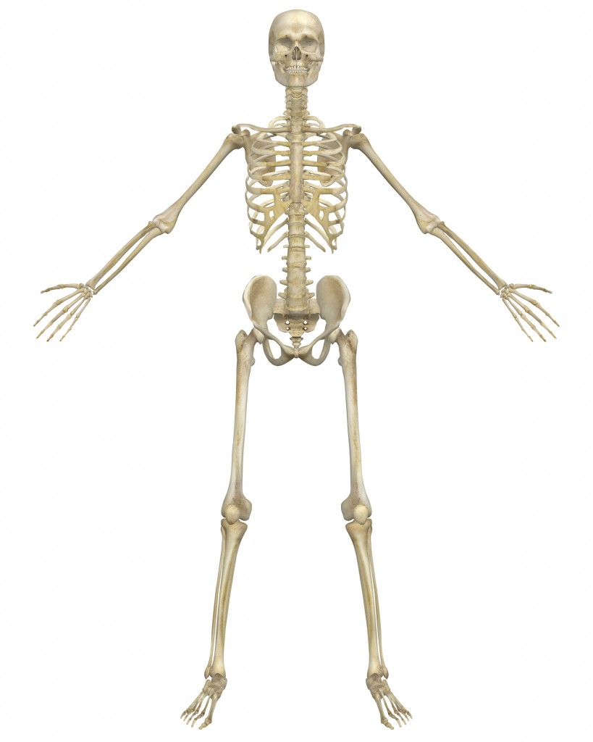
Surveillance: The Backbone of Public Health
Resource allocation
How much of the 2020 budget should go to prevention of vehicular injuries?
Outbreak detection, investigation
How much influenza
is expected in Uganda
in January?
Surveillance
Detecting new strains
Is this a new coronavirus or an old one in a new setting?
Monitoring interventions
Did raising the taxes on cigarettes lead to fewer cancer-associated illnesses?
Public health policy:
How many lives could we save if boda riders all wore helmets?
Placement of clinics, hospitals
What areas of Kampala would benefit most from a trauma center?
Notes:
Surveillance is the backbone of all activities in public health. If you don’t know what’s happening, how much of it is happening, where it’s happening, and to whom it’s happening, how can you expect to do anything about it? It should be obvious that what follows is that the surveillance has to be of good quality. (Go through examples on slide)

Slide 5
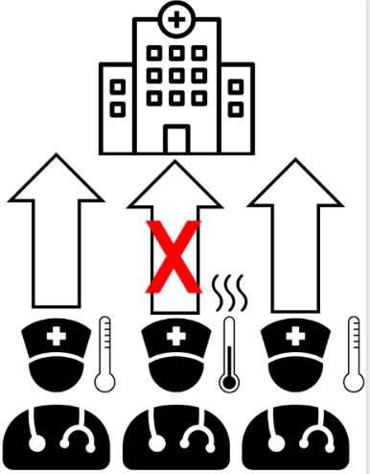

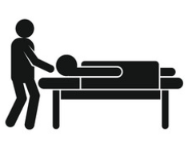
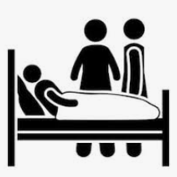


At all facilities:
At hospitals/HCIV:
Caregiver screening
Organizing a Hospital Surveillance Committee
Screening of healthcare workers
Triage outside of health facilities
Active surveillance among inpatients

Slide 6
Why conduct surveillance at health care facilities?
Protect healthcare workers and maintain health system integrity
Protect patients attending facilities from becoming part of a new chain
Enhance detection of concealed transmission chains in the community
Prevent health facility from becoming a focus of disease transmission
Notes:
Four main reasons to do this (read slide)

Slide 7

Three main tasks for districts:
Develop the structure of hospital-based surveillance at each hospital / high-volume facility
Organize and supervise COVID-19 Surveillance Committees at each hospital / high-volume health facility in the district
Support smaller facilities to conduct active case-finding for COVID-19 disease
Discussed in the next lecture
Notes:
To achieve this, we are asking districts to do THREE main tasks: (read each)
[CLICK] Support for smaller facilities will be discussed in the next lecture

Slide 8
Surveillance Structure at Hospitals

Slide 9
Structure of Staff Responsible
Assigns surveillance focal point for the hospital and each ward
Reviews surveillance report submitted by focal points daily
Convenes hospital surveillance committee meetings
Ensures the surveillance reports are submitted each day to DSFP
Medical superintendent (lead)
Hospital Surveillance Focal Person (operational lead)
Head of Hospital Lab
Ward / Unit In-Charges
Ensures operation of triage
Checks ward compliance with use of case-finding algorithm
Attends district COVID-19 surveillance meetings daily and provides updates on hospital surveillance for COVID-19
Ensures safe sample collection
Ensures safe sample shipment
Follows up on result return
Evaluate all inpatients each day based on case-finding algorithm
Send daily COVID-19 reports (including zero reporting) to Hospital Surveillance Focal Points
Notes:
Introduce staff and structure. Then use ‘appear’ function to review the responsibilities of the staff

Slide 10
Structure of Staff Responsible
Assigns surveillance focal point for the hospital and each ward
Reviews surveillance report submitted by focal points daily
Convenes hospital surveillance committee meetings
Ensures the surveillance reports are submitted each day to DSFP
Medical superintendent (lead)
Hospital Surveillance Focal Person (operational lead)
Head of Hospital Lab
Ward / Unit In-Charges
Ensures operation of triage
Checks ward compliance with use of case-finding algorithm
Attends district COVID-19 surveillance meetings daily and provides updates on hospital surveillance for COVID-19
Ensures safe sample collection
Ensures safe sample shipment
Follows up on result return
Evaluate all inpatients each day based on case-finding algorithm
Send daily COVID-19 reports (including zero reporting) to Hospital Surveillance Focal Points
Notes:
We mentioned that one of the activities of the medical superintendent is to convene hospital surveillance committee meetings. But what are these committees?

Slide 11
Surveillance Committees at Hospitals

Slide 12




What is a hospital surveillance committee?
A group of experts who know the hospital, community, and the issues who make the decisions about how best to protect their patients and staff

Slide 13
Committee Composition
No more than 10 people! May include:
  Director / medical superintendent
  Hospital administrator
  Ward in-charges from every ward
  OPD in-charge
  Head of records
  Senior nursing officer
  Head of lab
  District surveillance focal person or health management information system focal person

Slide 14
Facility surveillance committee tasks
Develop a hospital/HCIV COVID-19 surveillance plan with clear goals, objectives, and important core functions
Hold weekly review meetings to discuss case detection, validation, investigation, and reporting at the hospital/HCIV
Conduct quarterly CMEs to ensure all staff are sensitized on COVID-19, as well as Acute Flaccid Paralysis, measles, Neonatal Tetanus surveillance, and IDSR
Ensure that all job aids and surveillance guidelines are properly displayed and utilized by Health Care Workers in all departments of the facility

Slide 15
Requirements from committee members
Interest in being on the committee
Commitment to attend all meetings for which they are locally available
Able and willing to collect and analyze basic data from their wards / departments
Reliable reporters

Slide 16


Individual committee member tasks
  Conduct active surveillance for COVID-19 in their departments
  Provide case definitions, COVID-19 surveillance posters, tools, and ensure they are displayed and used
  Keep file of COVID-19 surveillance forms easily accessible by all workers in his/her department
  Notify the lead coordinator of the COVID-19 surveillance committee of any suspected COVID-19 case
Sensitize other Health Care Workers in his/her department about COVID-19
Conduct awareness talks on COVID-19 surveillance in OPD clinics

Slide 17
Who gets screened at health facilities?

Slide 18
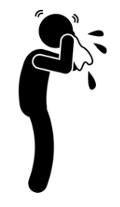
Community Case Definition
Any person or groups of persons with flu-like symptoms such as fever, running nose, sneezing, cough, sore throat and difficulty in breathing
This is the regular Acute Respiratory Illness you see in the community!
Notes:
Know the community case definition and sensitize people to it!!!

Slide 19
Four groups screened at facilities
All persons entering the facility for any reason
Inpatients
Caregivers
Healthcare workers

Slide 20
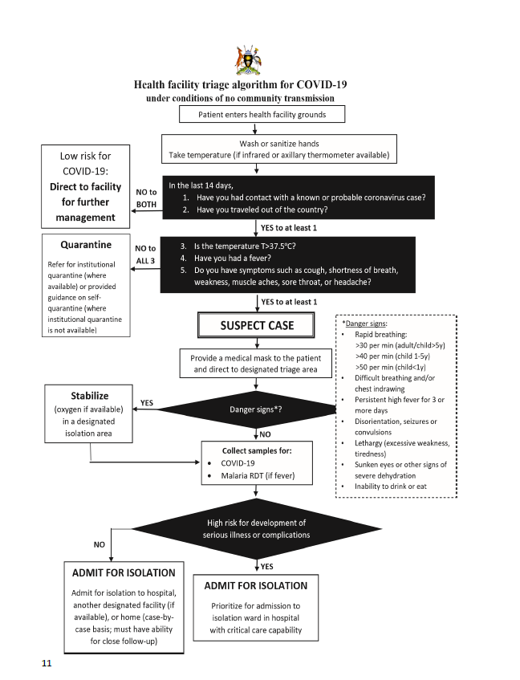
1. Screening for All Persons Entering Facility
ALL FACILITIES must have a triage
Screen patient for history and symptoms
  Asymptomatic persons with history of contact with case → quarantine
  Persons with symptoms of COVID-19 → isolated and tested
Notes:
Triage
If they fit suspected case def, then give a mask, isolate, HCW evaluates for severe symptoms. If yes, give O2 and take sample, if not, just take sample.

Slide 21
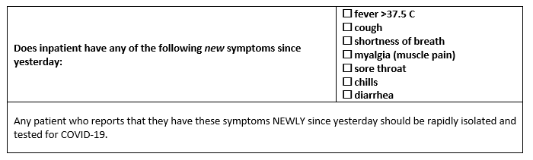
2. Screening for Inpatients
Conduct daily rounds for all inpatients using the tool below
Any inpatient newly presenting with these symptoms should be isolated and tested

Slide 22
3. Screening for caregivers
Caregivers are needed for the wellbeing of inpatients, but can also bring COVID-19 into the hospital
Avoid caregiver entry if at all possible
If it is required, it can be considered WITH appropriate PPE; ONLY ONE caregiver may be allowed
All caregivers should be screened for Acute Respiratory Illness any time they enter the facility, and tested if symptomatic

Slide 23
4. Screening of Healthcare Workers
MUST be screened for symptoms and exposures at the beginning of EVERY SHIFT
High-risk exposures → restrict from work x 14 days and tested on Day 14 to confirm absence of infection
COVID-19 symptoms → isolate and test
All healthcare workers providing direct care to COVID-19 patients should be tested every two weeks

Slide 24
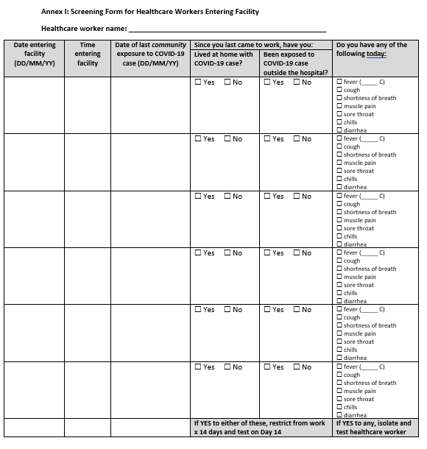
4. Screening of Healthcare Workers

Slide 25
Summary
Surveillance for COVID-19 in health facilities is critical to protect patients and staff
At all hospitals/HCIVs in their district, districts are responsible for:
  Developing structure for COVID-19 surveillance
  Overseeing the development of COVID-19 surveillance committees
  Ensuring screening / surveillance for COVID-19 takes place

Slide 26
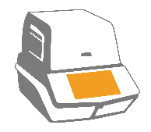
Review the Case definitions: Suspect, Probable and Confirmed case.
*Facility should print and pin up

