Slide 1

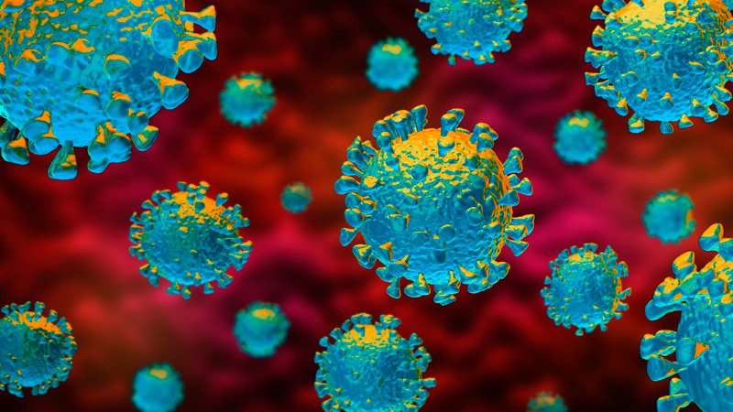
Module 02
COVID-19 OVERVIEW & TESTING STRATEGIES

Slide 2
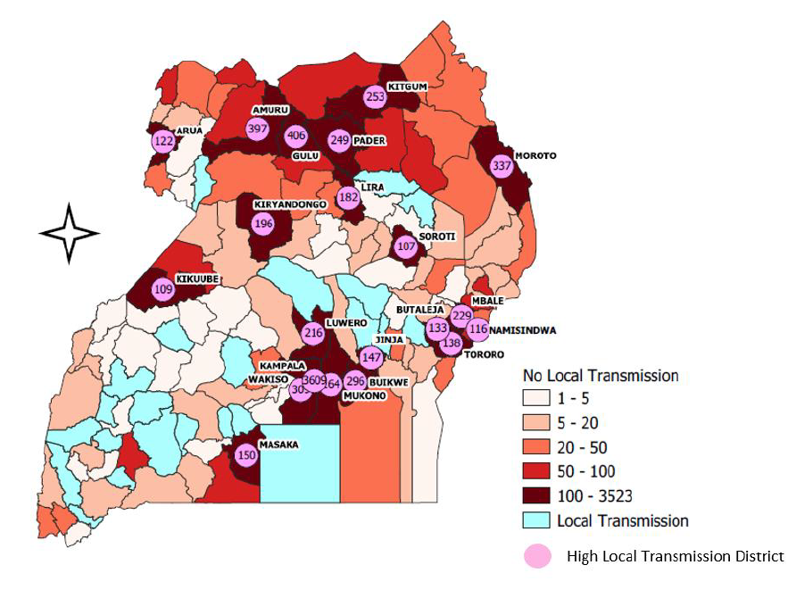
COVID-19 Overview
The COVID-19 pandemic is an ongoing pandemic caused by a novel coronavirus
  Pandemic = the worldwide spread of a disease
  Epidemic = widespread occurrence of an infectious disease in a community at a particular time
  Most countries in the world reported sustained community transmission of SARS-CoV-2
In Uganda, by 14th December 2020, there were 28,165 confirmed cases of COVID-19, with 221 deaths.
^{A} https://www.who.int/csr/disease/swineflu/frequently_asked_questions/pandemic/en/
^{B} https://www.cdc.gov/coronavirus/2019-ncov/faq.html
Graphic source: Managing epidemics: key facts about major deadly diseases. Geneva: World Health Organization; 2018. License: CC BY-NC-SA 3.0 IGO.

Slide 3


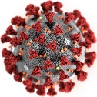
SARS-COV-2 Transmission
COVID-19 is transmitted through three modes:
  Contact transmission - spread through direct contact with an infection person and/or surface that has been contaminated.
  Droplet transmission - spread through exposure to virus-containing respiratory droplets generated through breathing, speaking, singing, coughing, sneezing, etc.
  Airborne transmission - spread through exposure to those virus-containing small respiratory droplets that can remain suspended in the air over long distances and time
Median: 5-6 days
2 3 4 5 6 7 8 9 10 11 12 13 14
15 16 17 18 19 20 21
Incubation period range (days)

Slide 4
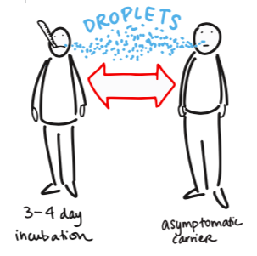
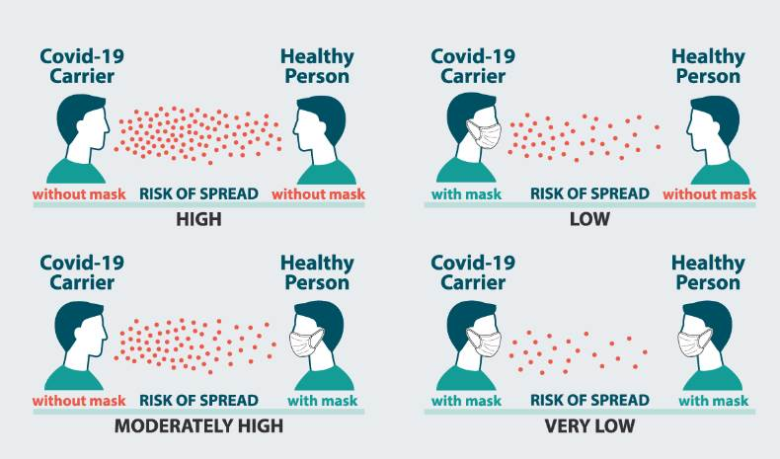
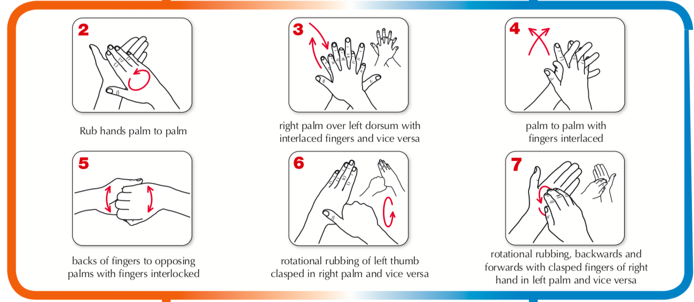
SARS-COV-2 Prevention
Effective preventive measures against CoV-19 infections include:
  Wash hands frequently with water and soap
  Sanitize hands with alcohol-based sanitizer
  Maintain social distancing of at least 2 meters
  Avoid touching eyes, nose, and mouth
  Wear face mask that covers nose and mouth
  If you have fever, cough, and difficulty breathing, seek medical care immediately
    Note: see Module 04 for additional safety and PPE guidelines

Slide 5
Benefits of Diagnostic Testing
Confirming infection in patients who fulfill the COVID-19 clinical case definition
Assisting the rapid triage of suspected cases (especially in community settings)
Screening for infection
  Particularly in asymptomatic contacts of confirmed COVID-19 cases
Managing contact tracing
Contributing to the global understanding of this new virus
  Determining exposure (current and past) to the virus
  Understanding the true extent of the outbreak
  Mapping the pandemic across countries
  Monitoring trends
Notes:
EXPLAIN: Thinking of Dr. Ghebreyesus’s emphasis on testing…
INVITE participants to DISCUSS with a partner:
- How can testing impact or disrupt the chain of transmission?
- What are some of the benefits of diagnostic testing?
ALLOW 3-5 minutes.
INVITE participants to SHARE with the group, and INVITE responses from women and men equally.

Slide 6
COVID-19 Testing strategies
Reverse transcription Polymerase Chain Reaction (rt-PCR)
  Laboratory technique combining reverse transcription of RNA into DNA and amplification of specific DNA targets using Polymerase Chain Reaction (PCR)
    It is primarily used to measure the amount of a specific RNA
  Use rt-PCR to detect the virus’s genetic material and allow for diagnosis of active infection
Antigen
  Any substance capable of stimulating an immune response
    Where immune system does not recognize the substance and is trying to fight it off
  These are specific proteins on the surface of the virus and may be used for screening or diagnosis, depending on the setting and performance
Antibody
  Y-shaped protein (immunoglobulin) made by the body’s immune system to recognize and attack foreign substances / in response to a threat, such as a specific virus
  Antibodies can take several days or weeks to develop after infection and may stay in the blood for several weeks after recovery
    Note: Antibody tests should not be used to diagnose active coronavirus infection

Slide 7
Diagnostic Testing Options
Category | Molecular Test | Antigen Test | Antibody Test
Format | rt-PCR device-based | RDT or POC device-based | RDT or lab-based ELISA
Detects | viral genetic material | viral proteins | antibodies that patient develop in response to infection
How | Based on Polymerase Chain Reaction (PCR) in which millions of copies of a specific section of the viral genome are made thereby amplifying small amounts of viral genetic material to detectible levels | Detects specific proteins on the surface of the virus | Based on the Enzyme Linked Immunosorbent Assay (ELISA) technique in which molecules attach to antibodies or antigens in the sample and produce a detectable signal
Utility | To diagnose active coronavirus infection |  | To identify past infection
Performed where | laboratory | laboratory, near patient | laboratory, near patient
Use Case | Diagnosis, screening, infection clearance | Diagnosis, screening, surveillance | Surveillance & seroprevalence studies only
How Not to Use | To determine past infection |  | To detect acute infection; immunity passports
Category | Molecular Test | Antigen Test | Antibody Test
Format | rt-PCR device-based | RDT or POC device-based | RDT or lab-based ELISA
Detects | viral genetic material | viral proteins | antibodies that patient develop in response to infection
How | Based on Polymerase Chain Reaction (PCR) in which millions of copies of a specific section of the viral genome are made thereby amplifying small amounts of viral genetic material to detectible levels | Detects specific proteins on the surface of the virus | Based on the Enzyme Linked Immunosorbent Assay (ELISA) technique in which molecules attach to antibodies or antigens in the sample and produce a detectable signal
Utility | To diagnose active coronavirus infection |  | To identify past infection
Performed where | laboratory | laboratory, near patient | laboratory, near patient
Use Case | Diagnosis, screening, infection clearance | Diagnosis, screening, surveillance | Surveillance & seroprevalence studies only
How Not to Use | To determine past infection |  | To detect acute infection; immunity passports
Category | Molecular Test | Antigen Test | Antibody Test
Format | rt-PCR device-based | RDT or POC device-based | RDT or lab-based ELISA
Detects | viral genetic material | viral proteins | antibodies that patient develop in response to infection
How | Based on Polymerase Chain Reaction (PCR) in which millions of copies of a specific section of the viral genome are made thereby amplifying small amounts of viral genetic material to detectible levels | Detects specific proteins on the surface of the virus | Based on the Enzyme Linked Immunosorbent Assay (ELISA) technique in which molecules attach to antibodies or antigens in the sample and produce a detectable signal
Utility | To diagnose active coronavirus infection |  | To identify past infection
Performed where | laboratory | laboratory, near patient | laboratory, near patient
Use Case | Diagnosis, screening, infection clearance | Diagnosis, screening, surveillance | Surveillance & seroprevalence studies only
How Not to Use | To determine past infection |  | To detect acute infection; immunity passports
Category | Molecular Test | Antigen Test | Antibody Test
Format | rt-PCR device-based | Rapid Diagnostic Test (RDT) or Device-based | RDT or lab-based ELISA
Detects | viral genetic material | viral proteins | antibodies that patient develop in response to infection
How | Based on Polymerase Chain Reaction (PCR) in which millions of copies of a specific section of the viral genome are made thereby amplifying small amounts of viral genetic material to detectible levels | Detects specific proteins on the surface of the virus | Based on the Enzyme Linked Immunosorbent Assay (ELISA) technique in which molecules attach to antibodies or antigens in the sample and produce a detectable signal
Utility | To diagnose active coronavirus infection |  | To identify past infection
Performed where | laboratory | laboratory, near patient (POC) | laboratory, near patient
Use Case | Diagnosis, screening, infection clearance | Diagnosis, screening, surveillance | Surveillance & seroprevalence studies only
How Not to Use | To determine past infection |  | To detect acute infection; immunity passports
Adapted from: https://www.fda.gov/consumers/consumer-updates/coronavirus-testing-basics
Notes:
Materials: none
Time: 15 min
EXPLAIN: Next, you will now consider what you already know about Diagnostic Testing Options.
INVITE participants to DIVIDE into 3 groups.
EXPLAIN the instructions. Each group will:
REVIEW their assigned type of Diagnostic Test
CONSIDER each component
PRESENT to the group
ASSIGN each group one type of diagnostic testing.
ALLOW 5 minutes for group brainstorm.
WALK AROUND and to OBSERVE and ASSIST where necessary.
INVITE each group to PRESENT their findings to the bigger group.
ALLOW 3 minutes per presentation.
CLICK to REVEAL answers after each presentation.
BRIEFLY COMPARE and CONTRAST the different types of diagnostic testing.

Slide 8
Antigen Testing
COVID-19 Antigen tests
  Are simple, easy to perform
  Give a rapid result (10-30 min)
  Decrease delays in diagnosis (through decentralized testing)
  Allow for expanded testing, as they can be used in community settings, outreaches
  Are usually less sensitive compared to molecular tests¹
  Are cheaper (acquisition costs, training testers, no need of complex infrastructure)
  Are good in detection of early SARS-CoV-2 infection
Types of Antigen tests available
  POC device-based
  RDT (visual-read Rapid Diagnostic Test)
COVID-19 Antigen testing should be conducted by trained and competent personnel in strict accordance with the manufacturer’s instructions
¹There are Antigen test that are highly sensitive and specific

Slide 9
Antigen Testing Use Cases
Use for:
Why: because symptoms indicate potential to transmit
Triage, Diagnosis, and Differential-diagnosis of symptomatic individuals
When widespread community impact & Over-burdened health systems
At-risk individuals
Suspected outbreaks (schools, care-homes, workplaces, etc.)
Remote settings / where molecular testing (NAATs/rt-PCR) not available
Monitoring among essential workers, healthcare workers
Detection in health facilities and testing centres
Asymptomatic individuals in contact with COVID-19 positive individuals
Why: because rapid diagnosis means more care for more patients
Why: catching, treating quickly can save lives, with/without symptoms
Why: to aid contact tracing
Why: because of quick, portable testing
Why: because of high risk of exposure and transmitting to others
Why: to protect all patients
Why: asymptomatic cases have high viral loads, easily detected with Ag-tests
Notes:
Participants can use their Materials – Use Case Flowchart for reference.
REVIEW Use Case scenarios together.
For each Use Case scenario:
ASK: Why?
ALLOW participants to BRAINSTORM and OFFER suggestions
*CLICK* to REVEAL answers
PROCEED one-by-one
*CLICK* to REVEAL Not for Use scenarios.
REVIEW Not for Use scenarios together.
For each Not for Use scenario:
ASK: Why?
ALLOW participants to BRAINSTORM and OFFER suggestions
*CLICK* to REVEAL answers
PROCEED one-by-one
INVITE responses from women and men equally.

Slide 10
Antigen Testing Do Not Use Cases
Not for Use:
Why: because positive results are likely to be “false positive”
Areas with zero or only sporadic cases
Where appropriate biosafety and infection prevention and control measures are unavailable
Where patient care does not change based on the result of the test
For airport or border screening at points of entry (if specificity is <99%)
In screening prior to blood donation
Why: because HCWs collecting samples are in danger of infection
Why: because irrespective of the result there is no benefit to the patient
Why: because the possibility of a positive result is low
Why: because having COVID-19 does not mean that the virus is in the blood
Notes:
Participants can use their Materials – Use Case Flowchart for reference.
REVIEW Use Case scenarios together.
For each Use Case scenario:
ASK: Why?
ALLOW participants to BRAINSTORM and OFFER suggestions
*CLICK* to REVEAL answers
PROCEED one-by-one
*CLICK* to REVEAL Not for Use scenarios.
REVIEW Not for Use scenarios together.
For each Not for Use scenario:
ASK: Why?
ALLOW participants to BRAINSTORM and OFFER suggestions
*CLICK* to REVEAL answers
PROCEED one-by-one
INVITE responses from women and men equally.

Slide 11
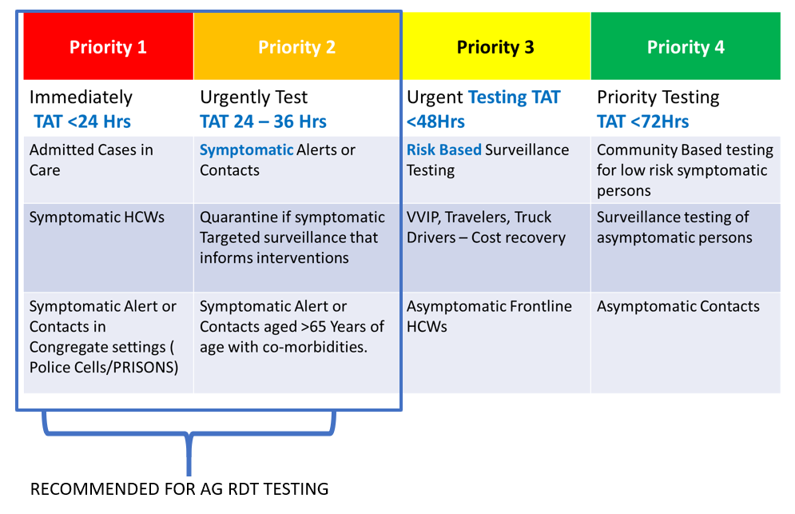
REVISED STRATEGY FOR COVID TESTING (October 2020)

Slide 12
REVISED ANTIGEN RDT-BASED TESTING SEQUENCE
Patient meets WHO case definition for symptomatic COVID 19
Priority 1 and priority 2 persons may be tested by Ag. RDT
Collect sample for RDT test
NEGATIVE RDT test
POSITIVE RDT test
HEALTH WORKERS TO PRACTICE ENHANCED IPC PRACTICES BUT TREAT AS HIGH-RISK PATIENT.
REFER TO COVID TREATMENT UNIT FOR IMMEDIATE MANAGEMENT
A SECOND SAMPLE IS TAKEN FOR CONFIRMATORY PCR TEST
Note: This will be revised by the MOH and communicated accordingly!!!

