Slide 1


Module 01
COVID-19 ANTIGEN TRAINING OVERVIEW

Slide 2
Covid-19 Antigen RDT rollout Objectives
Goal
To strengthen diagnostic capacity in the response to Covid-19 pandemic in Uganda
Objective
Build district capacity to train and supervise testers
Deploy Covid-19 antigen tests at facility level
Strengthen facility surveillance
Learning Outcomes
Good understanding of Covid19 pandemic and testing implications
Facility level surveillance set up
Roll out plan
National ToT
District orientation/Training
Facility
Training
Support Supervision

Slide 3

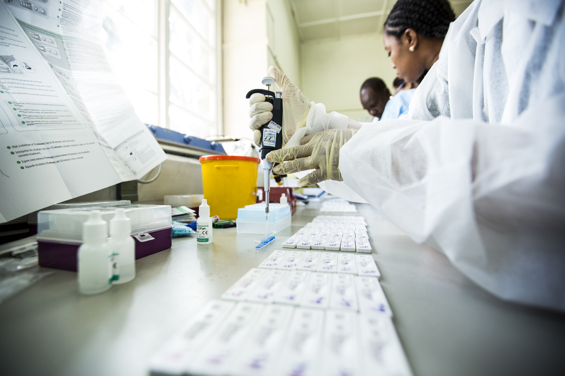
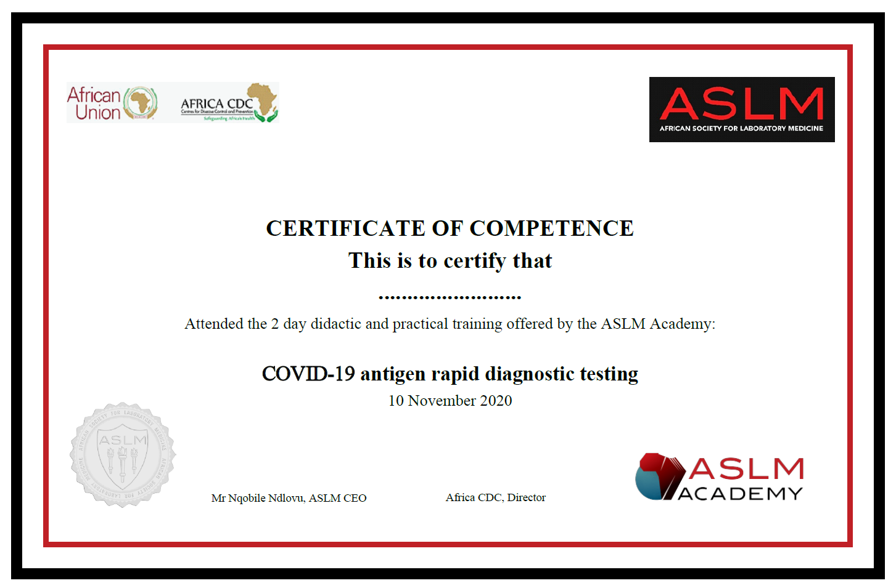
TRAINING COMPONENTS
1
Theory / Didactic
1 day training
2
Practical
½ day training
3
Certification
100 % attendance
80% pass mark - Theory
100% pass mark - Practical

Slide 4
TRAINING LAYOUT
Didactic
Physical
Practical
Delivered by Ag RDT Manufacturers or Authorized Trainers
Evaluation
Post test assessment (Theory & Practical)
Certification
Certificate award to deem tester competent
Delivered by certified national trainers

Slide 5
TRAINING MODULES
Module | Topic
Module 01 | Training Overview, Objectives and Schedule
Module 02 | COVID-19 Antigen Overview and Testing Strategy
Module 03 | Facility Surveillance
Module 04 | Safety, Infection Prevention and Control
Module 05 | Sample Collection and Referral
Module 06 | Antigen Testing (General Guidelines & Supplier-Specific Instructions)
Module 07 | Data and Information Management
Module 08 | Diagnostics and Supplies Inventory Management
Module 09 | Quality Assurance
Assessment | Assessments, Certification & Follow up

Slide 6
CERTIFICATION STEPS
A. Training | B. Assessment | C. Certification & Follow up
Certification
Practical test 2
ASLM reviews and awards Certificate
Theory test
SARS-COV-2 Ag RDT test & results interpretation
Pass mark = 100%
Certificates sent to Participants by email and/or Post
Pass mark=80%.
Tracking number trained
Continued correspondence by email, Social media
Trouble shooting & Updates
Follow up after Certification
Attend 1½-2 days didactic training
Pass mark =100% attendance
2
3
5
4
Trainer submits names of Participants to ASLM
1
Practical test 1
Start
Sample collection
Pass mark =100%
All training records (attendance lists, scores for theory and practical tests sent to ASLM by Trainers via email

Slide 7
Facility Level Training Cascade
National Trainers
(2 Lab, Surveillance, Manufacturere
DISTRICT TRAINING
DHTs(DHO, DLFP, DSFP, Clinician
Facility Team (Lab, SFP, Incharge, Clinician
FACILITY CME
Facility
X
Facility
Y
Facility
W
Facility
Z

Slide 8
Questions

Slide 9






Acknowledgement

