Slide 1
Module 07
DIAGNOSTICS AND SUPPLY INVENTORY MANAGEMENT

Slide 2
Supplies & Materials Checklist
Sample collection & transport:
New (unopened) sterile swab
PPE (gloves, gown, goggles, face mask N95)
Pen for marking or labeling
Specimen triple packaging supplies, where needed
Appropriate transport media where indicated
COVID-19 Antigen testing:
COVID-19 test kit
Alcohol, bleach, bottle, tissues, measuring device to make solution
Soap for hand washing
Leak-proof bag for containing or moving labeled biohazard waste
Waste container
Pen for marking or labeling
PPE (gloves, gown, goggles)
Timer
Positive and Negative controls
COVID-19 Antigen Test Logbook
Standard Operating Procedures
Thermometer

Slide 3
COVID-19 ANTIGEN TEST KITS
Typical COVID-19 Antigen test kits consists of:
RDT-visual read
Device-Based
Test (individually wrapped in foil pouch with desiccant)
Extraction buffer tube
Nozzle cap
Sterile swab
Paper stand
Instructions for use
Test strip (individually wrapped in foil pouch with desiccant)
Extraction Vial
Dropper Lid
Instructions for use

Slide 4
Stock Management Introduction
Stock Management is:
The practice of ordering, storing, tracking, and controlling (antigen testing) inventory
Benefits of proper Stock Management:
Ensures availability of materials and kits, when needed
Avoids the use of expired kits → minimizes wastage and uses time wisely
Leads to uninterrupted testing
Note:
Stock Management refers to management of testing-related items that will run out or be used up during the testing process.
Additional considerations should be taken to ensure correct management, storage, and maintenance of long-term assets, like POC-device instruments and phone access.

Slide 5
Stock Management Steps
Stock Management involves knowing:
What the specifications of supplies and kits areª
What and how many supplies/consumables you have
When and how to order
What and how much stock was ordered (and when)
Where to store stock
When and how much fresh stock was received, and by whom
ª Only use tests approved in your country. Ensure that country requirements for sample collection swabs, disinfectants and PPE are followed. Only obtain supplies from reputable suppliers

Slide 6
Stock Management Cycle
Performing stock count
Maintaining proper inventory records
Determining when to re-order
Determining how much to order
Placing orders properly
Inspecting delivery of new orders
Ensuring proper storage of stock

Slide 7
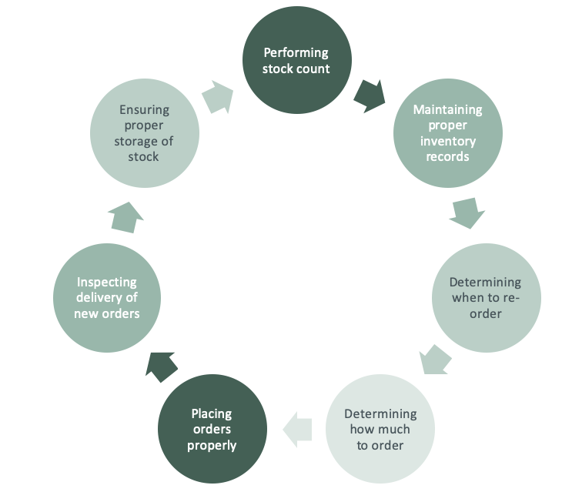
Stock Count
Stock Count is:
Physically counting each item in the stock
Stock Count is performed:
(Recommended) at the beginning of each week or month, depending on the established Standard Operating Procedures (SOPs)
By a designated person in the healthcare facility
Stock Count is important because:
All items must be accounted for
Everything that comes in and goes out must be recorded

Slide 8
Maintaining Proper Inventory Records
Inventory Records are important because:
They are the written register of what is on-hand at the healthcare facility
Stock Cards
Simple, heavy weight cards
Kept for each item in stock
To be filled out by site staff using their own normal stock cards as part of routine in the health facility
Stock Book or Register
Contains listing of all items in the store
Update weekly after physical count from information on the stock cards

Slide 9
When to order
Analyze the needs of the facility by making a list of the all the required reagents and supplies:
A detailed description of each item used for sample collection and testing
The package count or number of units in which the item is supplied
Approximate usage per month
The priority or importance-level for testing
For example: Is it used every day or only once a month?
The length of time required to receive a delivery
For example: Will the order take a day, week, or month to arrive?
Storage space and conditions
For example: Will a bulk order use too much storage space? Does it require refrigeration?
The facility must place orders when the stocks are low, not when stock has run out

Slide 10
How to order
Establish a list of supplies to be ordered
Complete a purchase order, and have it approved according to the clinical facility’s procedure
Forward the purchase order to the procurement officer for processing and ordering
The supplies are added to the current inventory and stored according to manufacturer’s instructions
a The mechanism for ordering supplies may need to be adapted to account for central procurement and distribution

Slide 11
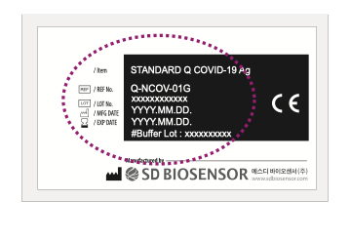
Upon Receipt of New Orders
Inspect delivery of new orders:
Verify contents of order received with requisition (for accuracy)
Check integrity of received supplies
Note any damaged or compromised materials
Update (or create) inventory records:
Date each item received
Expiration date
a The mechanism for receiving supplies may need to be adapted to account for central procurement and distribution. E.g. Inform supervisory or central level on any problems with stock received

Slide 12
Ensure Proper Storage of Inventory
Place items on shelves, storing new shipment behind existing shipment
Store according to manufacturer’s instructions (usually 2-30°C)
Record the temperature
Store away from direct sunlight
Keep the storeroom clean, organized, and locked

Slide 13
Managing stock
Label all supplies and reagents with date received and the date first opened
Decide on stock levels based on current knowledge of supply availability and frequency of re-supply
Rotate stock using “First Expired, First Out” (FEFO) principles
This ensures that out-of-date reagents are not used
If there are expired reagents, they should be separated, marked “Expired – Do not use”, and then discarded according to manufacturer’s instructions

Slide 14
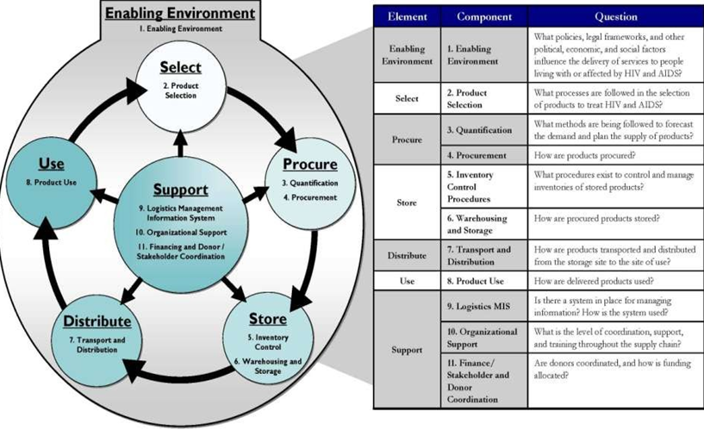
LOGISTICS CYCLE

Slide 15
Questions

