Slide 1
TBHIV DATA REVIEW
Dr. Proscovia Namuwenge
Senior program Officer Tbhiv- moh

Slide 2
The context: Health Information System
Health Information System (HIS) is one of the six building blocks of the health system (WHO, 2000)
HIS: has been described as:
the “foundation” for better health
the “glue” holding the health system together
the “oil” keeping the health system running
Its primary function is fostering evidence-based decision making (EBDM). vital to the effectiveness of the health system as a whole (Health Metrics Network, HMN).

Slide 3
Context lies in Health Information Systems
Ultimate goal of HIS:
to “collect, process, report and use health information and knowledge to influence policymaking, program action and research, AbouZahr and Boerma (2005).
Quality and timely data from HIS
are the foundation of the health system and
inform decision making in each of the other five building blocks of the health system

Slide 4
1. TBHIV INDICATORS IN HMIS
HIV clients screened for TB
HIV clients diagnosed with TB
HIV clients with TB on treatment
PLHIVs enrolled on isoniazid preventive therapy (IPT)
PLHIVs who completed a course of IPT

Slide 5
2. TBHIV INDICATORS IN HMIS
TB patients offered and tested for HIV
HIV positives among those tested.
TB-HIV patients on CPT
TB-HIV patients on ART

Slide 6
TBHIV Cascade FY 2017/18: Identifying HIV among TB cases

Slide 7
HIVTB Care Cascade FY 2017/18; ICF IN HIV CLINICS

Slide 8
Question
Is it true that in HIV clinics so many TB cases are diagnosed and few are initiated?

Slide 9
observed Errors in Tbhiv indicators
DQAs of TB status data to improve quality (reduce pen screening)

Slide 10
Buikwe; Tbhiv data quarter January to march 2018
Three facilities reported 2001 out of the 2072 TB cases in this qtr

Slide 11
Bulambuli; Tbhiv data quarter January to march 2018
One facility reported 2371 out of the 2379 TB cases in the qtr

Slide 12
What needs to be done
Quarterly data review meetings
Performance reviews
Continue conducting DQAs while paying attention to the TBHIV data elements/indicators

Slide 13
Tbhiv updates
MOH HAS received isoniazid 100mg sufficient for all PLHIV 0-14 years & under-5-year contacts of PBC TB patients
It is scheduled to receive isoniazid 300mgs sufficient for 500,000 PLHIV >15years and above by Dec 2019

Slide 14
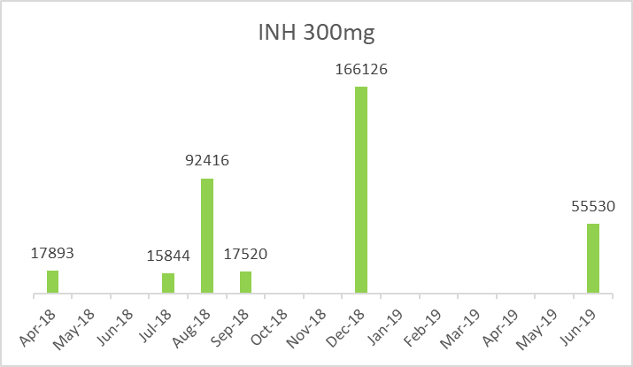
Isoniazid 300mg stock status

Slide 15
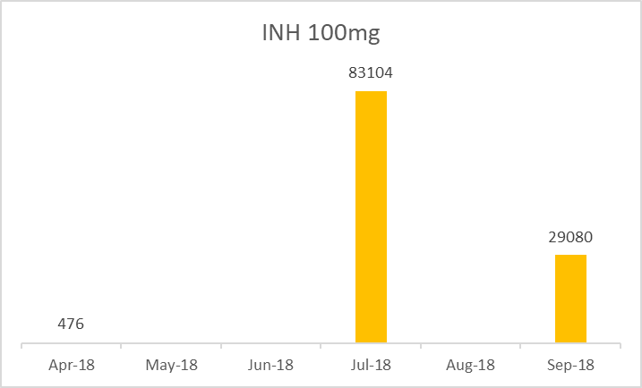
Isoniazid 100mg stock status

Slide 16
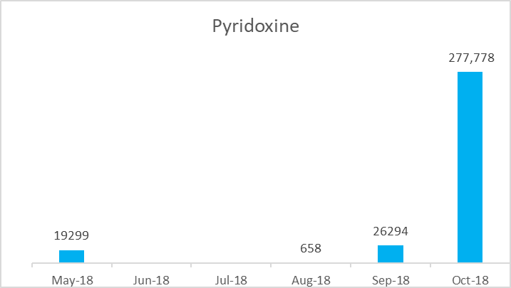
Pyridoxine stock status

Slide 17
Tb prevention; enrollment
 | Jan to Mar 2018 | Apr to Jun 2018
 | 106a Pre-ART No. of clients started on INH Prophylaxis during the reporting quarter | 106a Pre-ART No. of clients started on INH Prophylaxis during the reporting quarter
Central Region | 1278 | 1772
Eastern Region | 711 | 645
Northern Region | 312 | 519
Western Region | 488 | 489
MOH - Uganda | 2789 | 3425
Expcted = 17893 | Achievement Jan to Jun = 6214, shortfall =11,679 (65%)

Slide 18
Challenges of ipt
Enrollment is still low
Reporting rates still low, e.g. 1107 started on INH in July and so far only 23 reported in August
Completion rates are low

Slide 19
Ipt Scale up plan
469 health units with 568,572 PLHIV new & active on ART are implementing the surge strategy to mop up the remaining PLHIVS
The same health units to be targeted and supported in phases to intensify IPT implementation
Required; strengthened monitoring to ensure that 500,000 PLHIV are enrolled & complete on IPT by Dec 2019

