Slide 1
Data and information management for RDT roll out
December 17th , 2020
Ntale Jonathan (CDC) & Milton Kaye (MUSPH-METS)

Slide 2
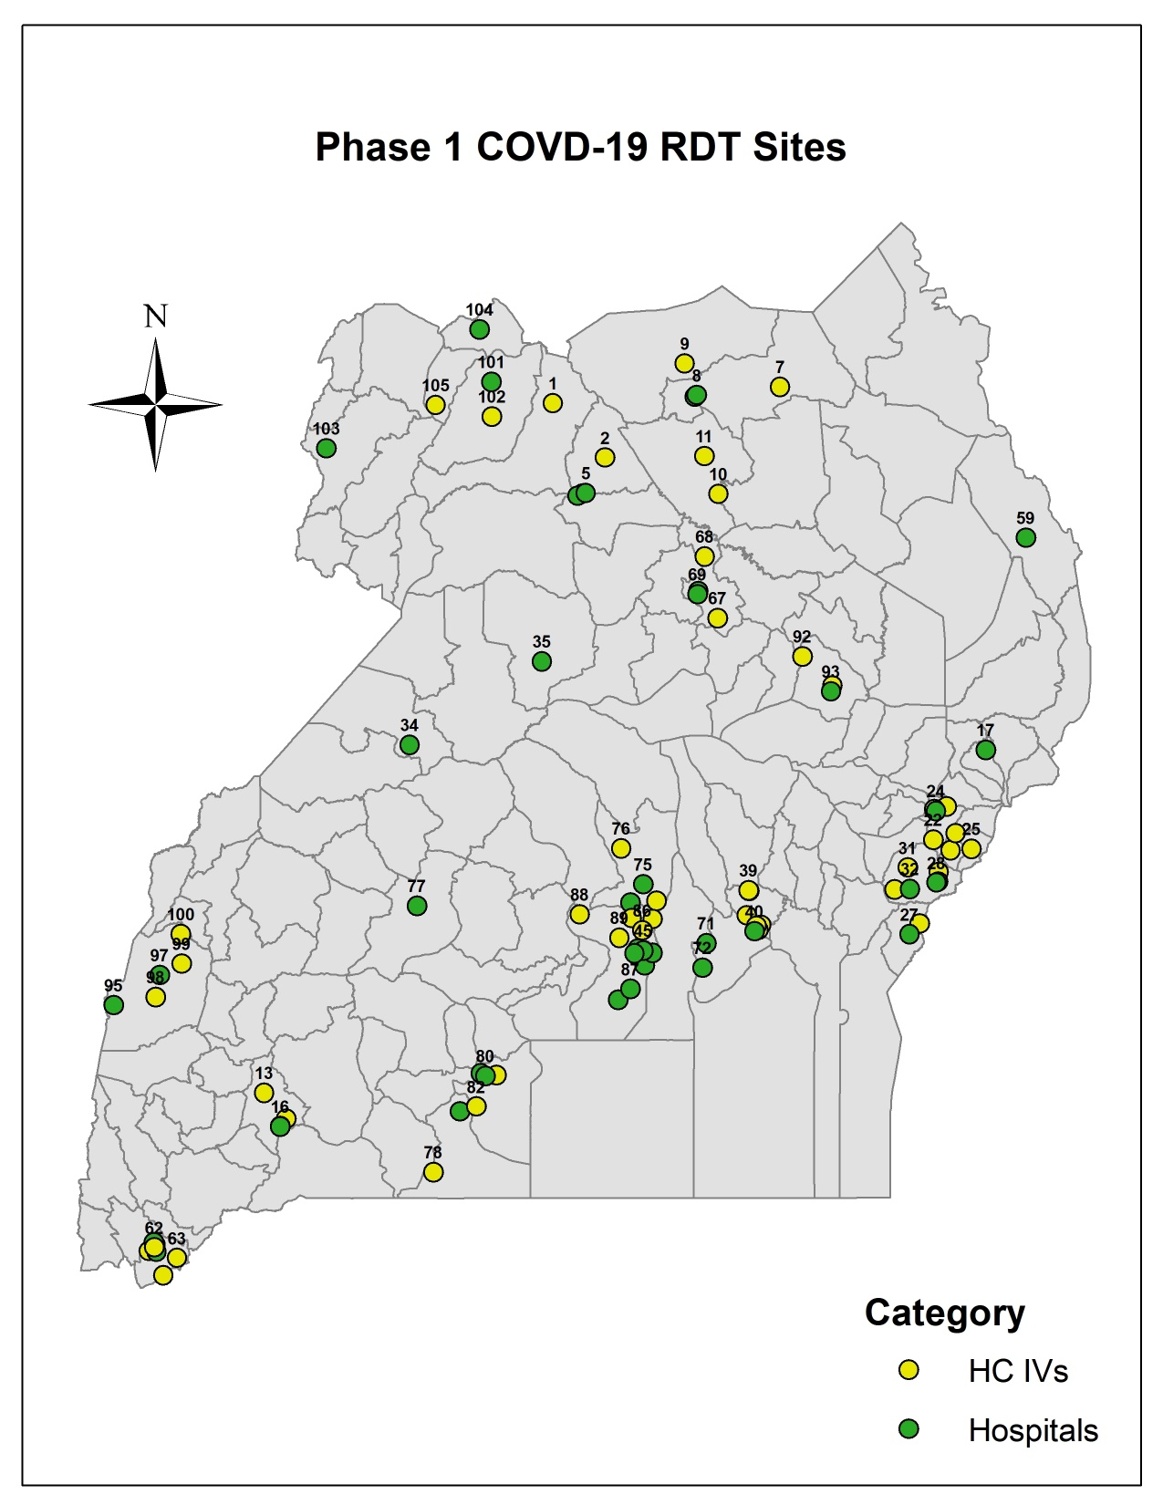
CATEGORY OF FACILITY | VOLUME OF AG. RDTs
Border | 200
HC IVs | 10,200
Hospitals | 21,300
PoE | 1,300
Prison HC | TBD
 | 33,000
PoEs also Included;
Alegu
Opotpot
Kamion
Usake
Nakapelimon
Others Include;
Mirama Boarder
Kasese Hospital
Others Include;
Kitintale HC IV
Kawempe NRH
Murchison Bay Prison

Slide 4
HOW WE HOPE TO MANAGE DATA AT HEALTH FACILITIES
CPHL SENDS RDTs (PUSH-SYSTEM)
FACILITY LAB RECEIVES THE TEST KITS
FACILITY LAB RECORDS STOCK IN STOCK CARD
DATA ON POSITIVES & NEGATIVES REPORTED NEXT DAY BY 9.00AM USING RASS
DATA ON STOCK REPORTED AT THE END OF THE WEEK USING RASS
LAB PERSONS RECORDS IN STOCK CARD
TRIAGE NURSE, CLINICIAN etc.
RECORD DATA FROM L.I.F INTO GENERAL HMIS REGISTER (HMIS LAB 011 )
STAFF USE L.I.F PRIOIR TO TESTING
FACILITY LAB DISTRIBUTES KITS TO TARGET DEPARTMENTS

Slide 5
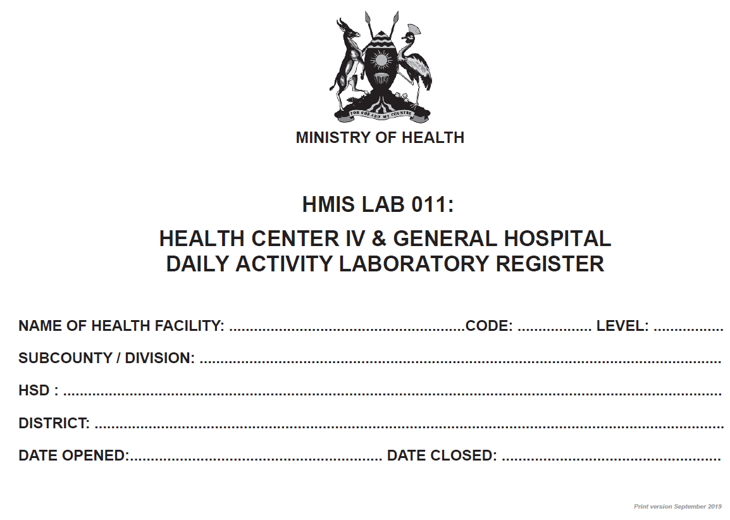

Slide 6
KEY COLUMNS TO FILL IN THE HMIS LAB 011

Slide 7
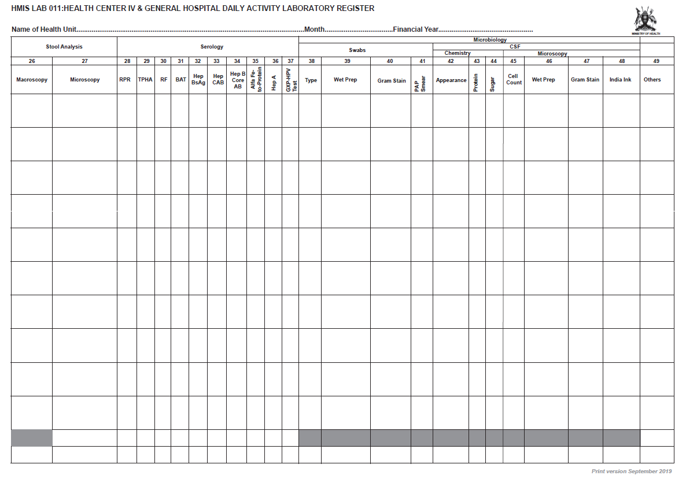

Slide 8
How the filed teams shall relay data for timely epidemiological response

Slide 9
HOW WE HOPE TO MANAGE DATA AT HEALTH FACILITIES
CPHL SENDS RDTs (PUSH-SYSTEM)
FACILITY LAB RECEIVES THE TEST KITS
FACILITY LAB RECORDS STOCK IN STOCK CARD
DATA ON POSITIVES & NEGATIVES REPORTED NEXT DAY BY 9.00AM USING RASS
DATA ON STOCK REPORTED AT THE END OF THE WEEK USING RASS
LAB PERSONS RECORDS IN STOCK CARD
TRIAGE NURSE, CLINICIAN etc.
RECORD DATA FROM L.I.F INTO GENERAL HMIS REGISTER (HMIS LAB 011 )
STAFF USE L.I.F PRIOIR TO TESTING
FACILITY LAB DISTRIBUTES KITS TO TARGET DEPARTMENTS

Slide 10
Purpose of regular reporting
Why we are using RASS system for now
Stock monitoring: To enable district and national teams have timely updates on stock status and thus maintain adequate stock of test kits at the target sites
Facility based surveillance: To enable district and national teams have a quick feel of positivity rates recorded at the health facilities.
Ease of use: To system allows (a) SMS reports and (2) internet-based DHIS2 system
Availability: RASS is already in use for 3+ years at over 1,000 health facilities and is aligned to the master facility list
Low quantity of data: To system allows (a) SMS reports
Minimal data needed

Slide 11



Tracking COVID-19 RDTS using mTRAC/RASS
MILTON Kaye, HIS Analyst
mkaye@musph.ac.ug

Slide 12
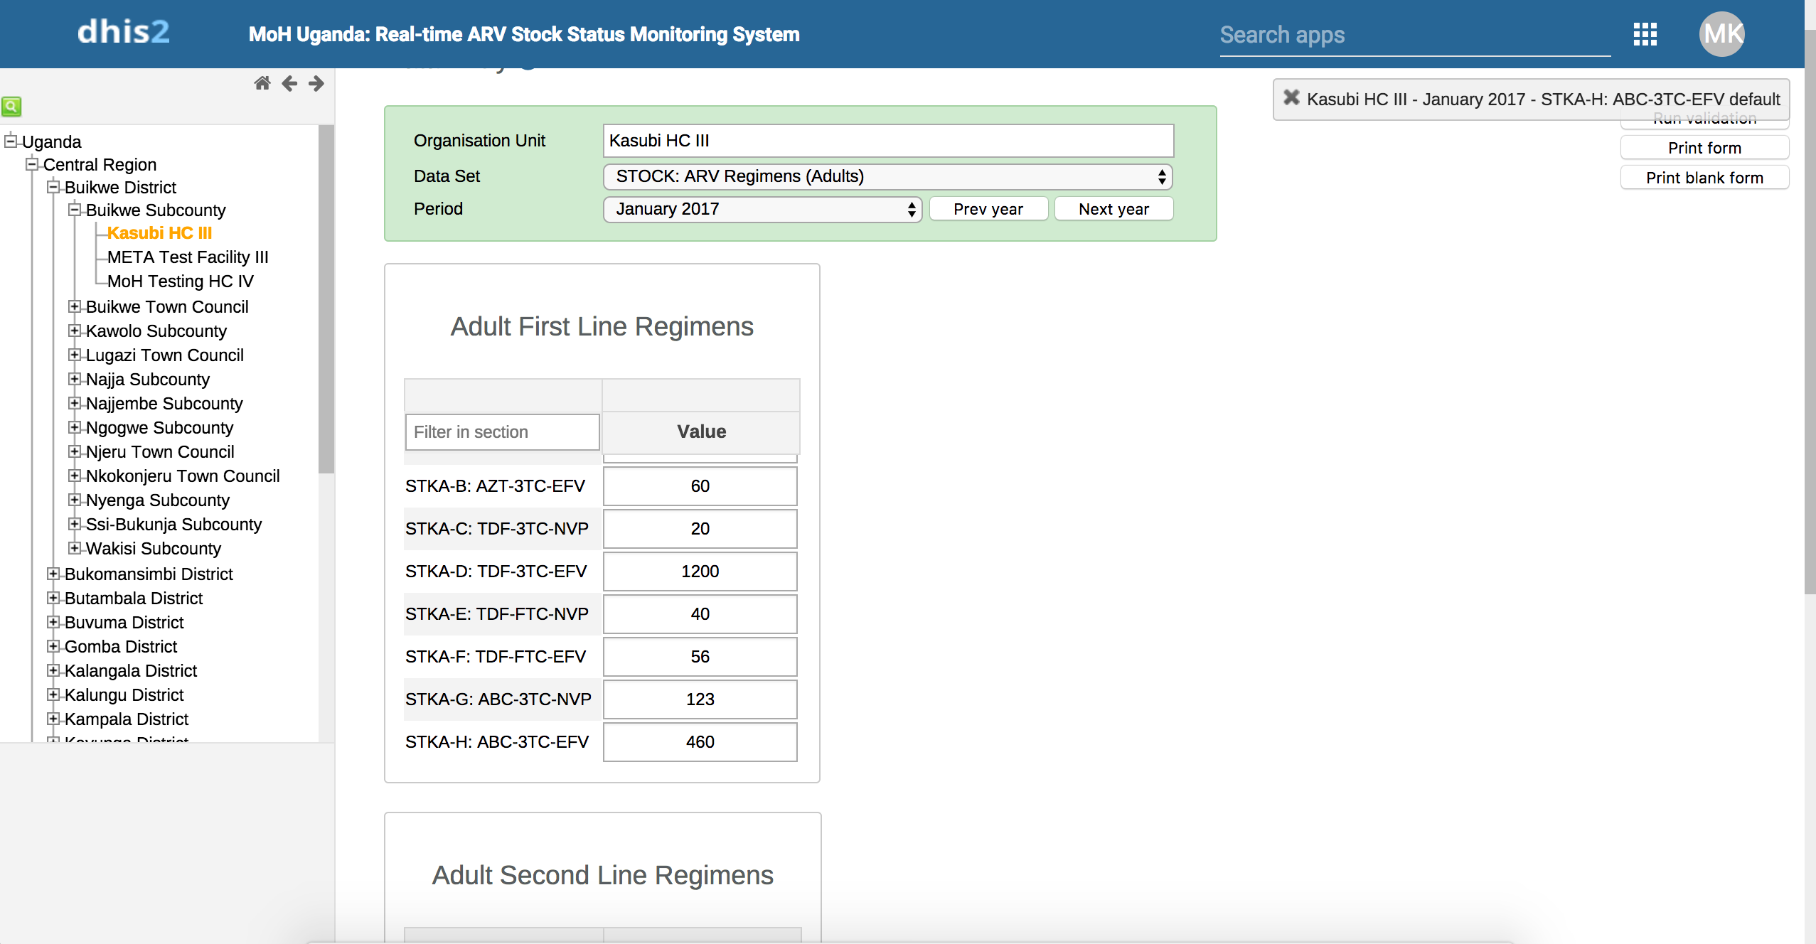
RASS?
SMS & web-based application platform that allows for consistent & timely monitoring of commodity stock levels at Health facilities
Interactive web-based dashboard that summarizes stock from facility, district, regional, and national levels
Aggregates and manages facility reports in DHIS2.
  Captures facility-based data on a daily and weekly basis.
  Data from primary data collection tools (Stock Card/LIF)
Obtains real time data on commodities.
  SWABS
  RDTS
  PCR
Capture data on;
  Current Stock
  Received Stock
  Positivity Data
Data capture is based on DHIS2
Reports submitted using SMS (mTrac) to DHIS2
Notes:
High-level Decision Support System
Monitors and reports stock status of ARV and RTK commodities.
Facilities report Stock levels via SMS DAILY & WEEKLY to RASS (option to enter information through DHIS 2 for facilities with internet capability)
TRANSPERANCY of data = RASS=public site that can be accessed by all stakeholders (HFs, warehouses, government agencies, patients, etc.)
Orders placed vs. Orders received: RASS is utilized to reconcile order information from WAOS; when HFs receive an order they report it through RASS.
WAO & RASS linkage: Information pertaining to the # of patients on regimens from WAOS are incorporated into RASS to generate the # of patients affected by stock outs at each facility.
Various Reports: ARVs (Adult & Pediatric), TB, Rapid Test Kits.

Slide 13
How RASS works?
Facilities utilize stock cards/LIF to collect information
  Qty on hand
  Qty received
  Results data
Using predefined coding, facilities text (SMS) their responses to 6767 (mTrac)
Data is transmitted to RASS (Online DHIS2 Instance)
  Web
  SMS
Status can be viewed on the RASS Dashboard

Slide 14
COVID-19 Datasets (Reports)
Current Stock (STOCK) report
  This collects the current stock (balance on hand) of one or many of the tracked (coded) COVID-19 commodities on a weekly basis.
Test Results (STOCK) report
  This collects the test results data on a weekly basis.
Received Stock (RCVD) report
  This collects the received stock (quantity received) of the one or many of the tracked (coded) COVID-19 commodities on a daily or weekly basis.

Slide 15
mTRAC / RASS Reporting
All reporter’s phone numbers must be PRE-registered in the system and associated with the facility they report for.
  This can be done by a system user with user management rights
Two approaches of submitting mTRAC / RASS reports
  Using SMS (recommended)
  Using the online system (https://dhis.mets.or.ug)

Slide 16
How to get activated to send weekly reports in mTRAC/RASS
Facility undergoes COVID 19 RDT training
During the training, identify at least two health facility staff who will be sending weekly SMS (most preferably during the RDT training)
Send their phone numbers to trainers for onward submission for pre- registration onto mTRAC/RASS.
(Trainers forwards contacts to CPHL COVID M&E person)
PERSONS TO BE REGISTERED
Both lab staff or Data/Stores assistant
DETAILS NEEDED FOR STAFF REGISTRATION:
Name, health facility, staff cadre, preferred phone numbers.
SEND EMAIL TO: Claire Nankoma clairen414@gmail.com
EMAIL REF: Registration for COVID reporting by SMS
FACILITY STAFF READY TO SENT WEEKLY SMS TO 6767 USING SOPs
FACILITY STAFF WILL RECEIVE AN SMS SHOWING THAT THEY HAVE BEEN REGISTERED

Slide 17
What are the key data elements to report?
COMMODITIES
(a) CURRENT STOCK and (b) COMMODITIES RECEIVED
2. TESTS DONE
Note: the week format used is = Monday to Sunday
e.g. Monday 03rd May---- to---- Sunday May 09th 2021
i.e. data reported is from Monday to Sunday

Slide 18
HOW TO GENERATE A WEEKLY REPORT
(refer to SOP document)
A weekly report is made up of 3 separate SMS sent by a facility
SMS #1
SMS #2
SMS #3
RESULTS
[Report Code: STOCK]
To generate an SMS report, use the general format below;
CURRENT STOCK
[Report Code: STOCK]
To generate an SMS report, use the general format below;
RECEIVED STOCK
[Report Code: RCVD]
To generate an SMS report, use the general format below;

Slide 19
Web-based format of the weekly report (optional)
This format is ideal for facilities that have readily available internet resources
Same process for pre-registration like the SMS reporting but doesn’t need the SMS codes.
This web-based training is optional and takes about 10 minutes.
Contact CPHL COVID M&E person to schedule the training on bi-weekly basis (clairen414@gmail.com)
Demo - online system
System URL: https://dhis.mets.or.ug
Demo Account
Username: demo
Password: Demo1234
Note: the week format used is = Monday to Sunday
e.g. Monday 03rd May---- to---- Sunday May 09th 2021
i.e. data reported is from Monday to Sunday

Slide 20



@metsprogrammeug
http://mets.or.ug/

