Slide 1
TB LAM IMPLEMENTATION IN UGANDA
ASIIMWE RAYMOND

Slide 5
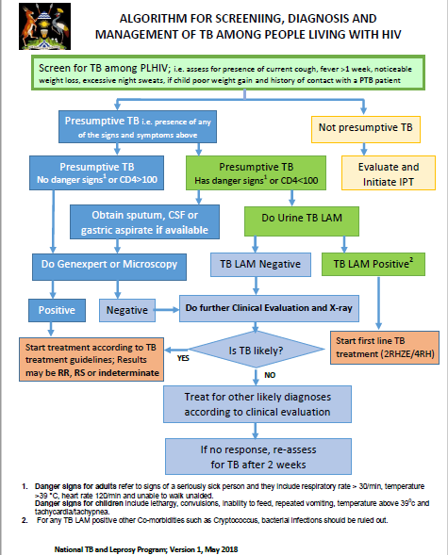

Slide 7
Preliminary findings, January to March 2018

Slide 14
Some challenges
Inadequate trainings
Diversion from correct use of LAM
Improper classification of patients
Low utilization

Slide 15
TB LAM Data collection tool
Period_________________________________________
Stock received
Stock at hand
Total number of tests done = 1 + 2
Reason(s) for none utilization if no test is done
Number Males 3. Number HIV Positive
Number Females 4. Number HIV Positive
Total number of tests done on HIV positive clients = 3 + 4
Total Number with Positive TB LAM
Total Number linked to care
Reason(s) for none linkage to care: Died, LTFU, etc
Number of tests done on adults = 5 + 6
Reason(s) for none utilization if no test is done
5. Number Males 7. Number HIV Positive
6. Number Females 8. Number HIV Positive

Slide 16
Number of tests done on HIV positive adults = 7 + 8
Total Number with Positive TB LAM
Total Number linked to care
Reason(s) for none linkage to care: Died, LTFU, etc
Number of tests done on children = 9 + 10
Reason(s) for none utilization if no test is done
9. Number Males 11. Number HIV Positive
10. Number Females 12. Number HIV Positive
Number of tests done on HIV positive children = 11 + 12
Total Number with Positive TB LAM
Total Number linked to care
Reason(s) for none linkage to care: e.g. Died, LTFU, etc
Additional Comments

Slide 17
Thank you

